Slide 2
ABOUT US

Slide 3
Fernanda Dantas
International Affairs Manager at CBL and Executive Manager at Brazilian Publishers
Fernanda holds a B.A. degree in History from PUC-SP and specializations in management and marketing.
Since 2016, she is part of CBL International Affairs team.

Slide 4
Brazilian Book Chamber
Founded in 1946, the Brazilian Book Chamber gathers publishers, distributors, booksellers and door-to-door players around a fundamental cause: the construction of a country with better education through books and reading.
Represents more than 500 associates all around Brazil.
Works with three goals: political action, business development and support for the associates.
Visit Us

Slide 5
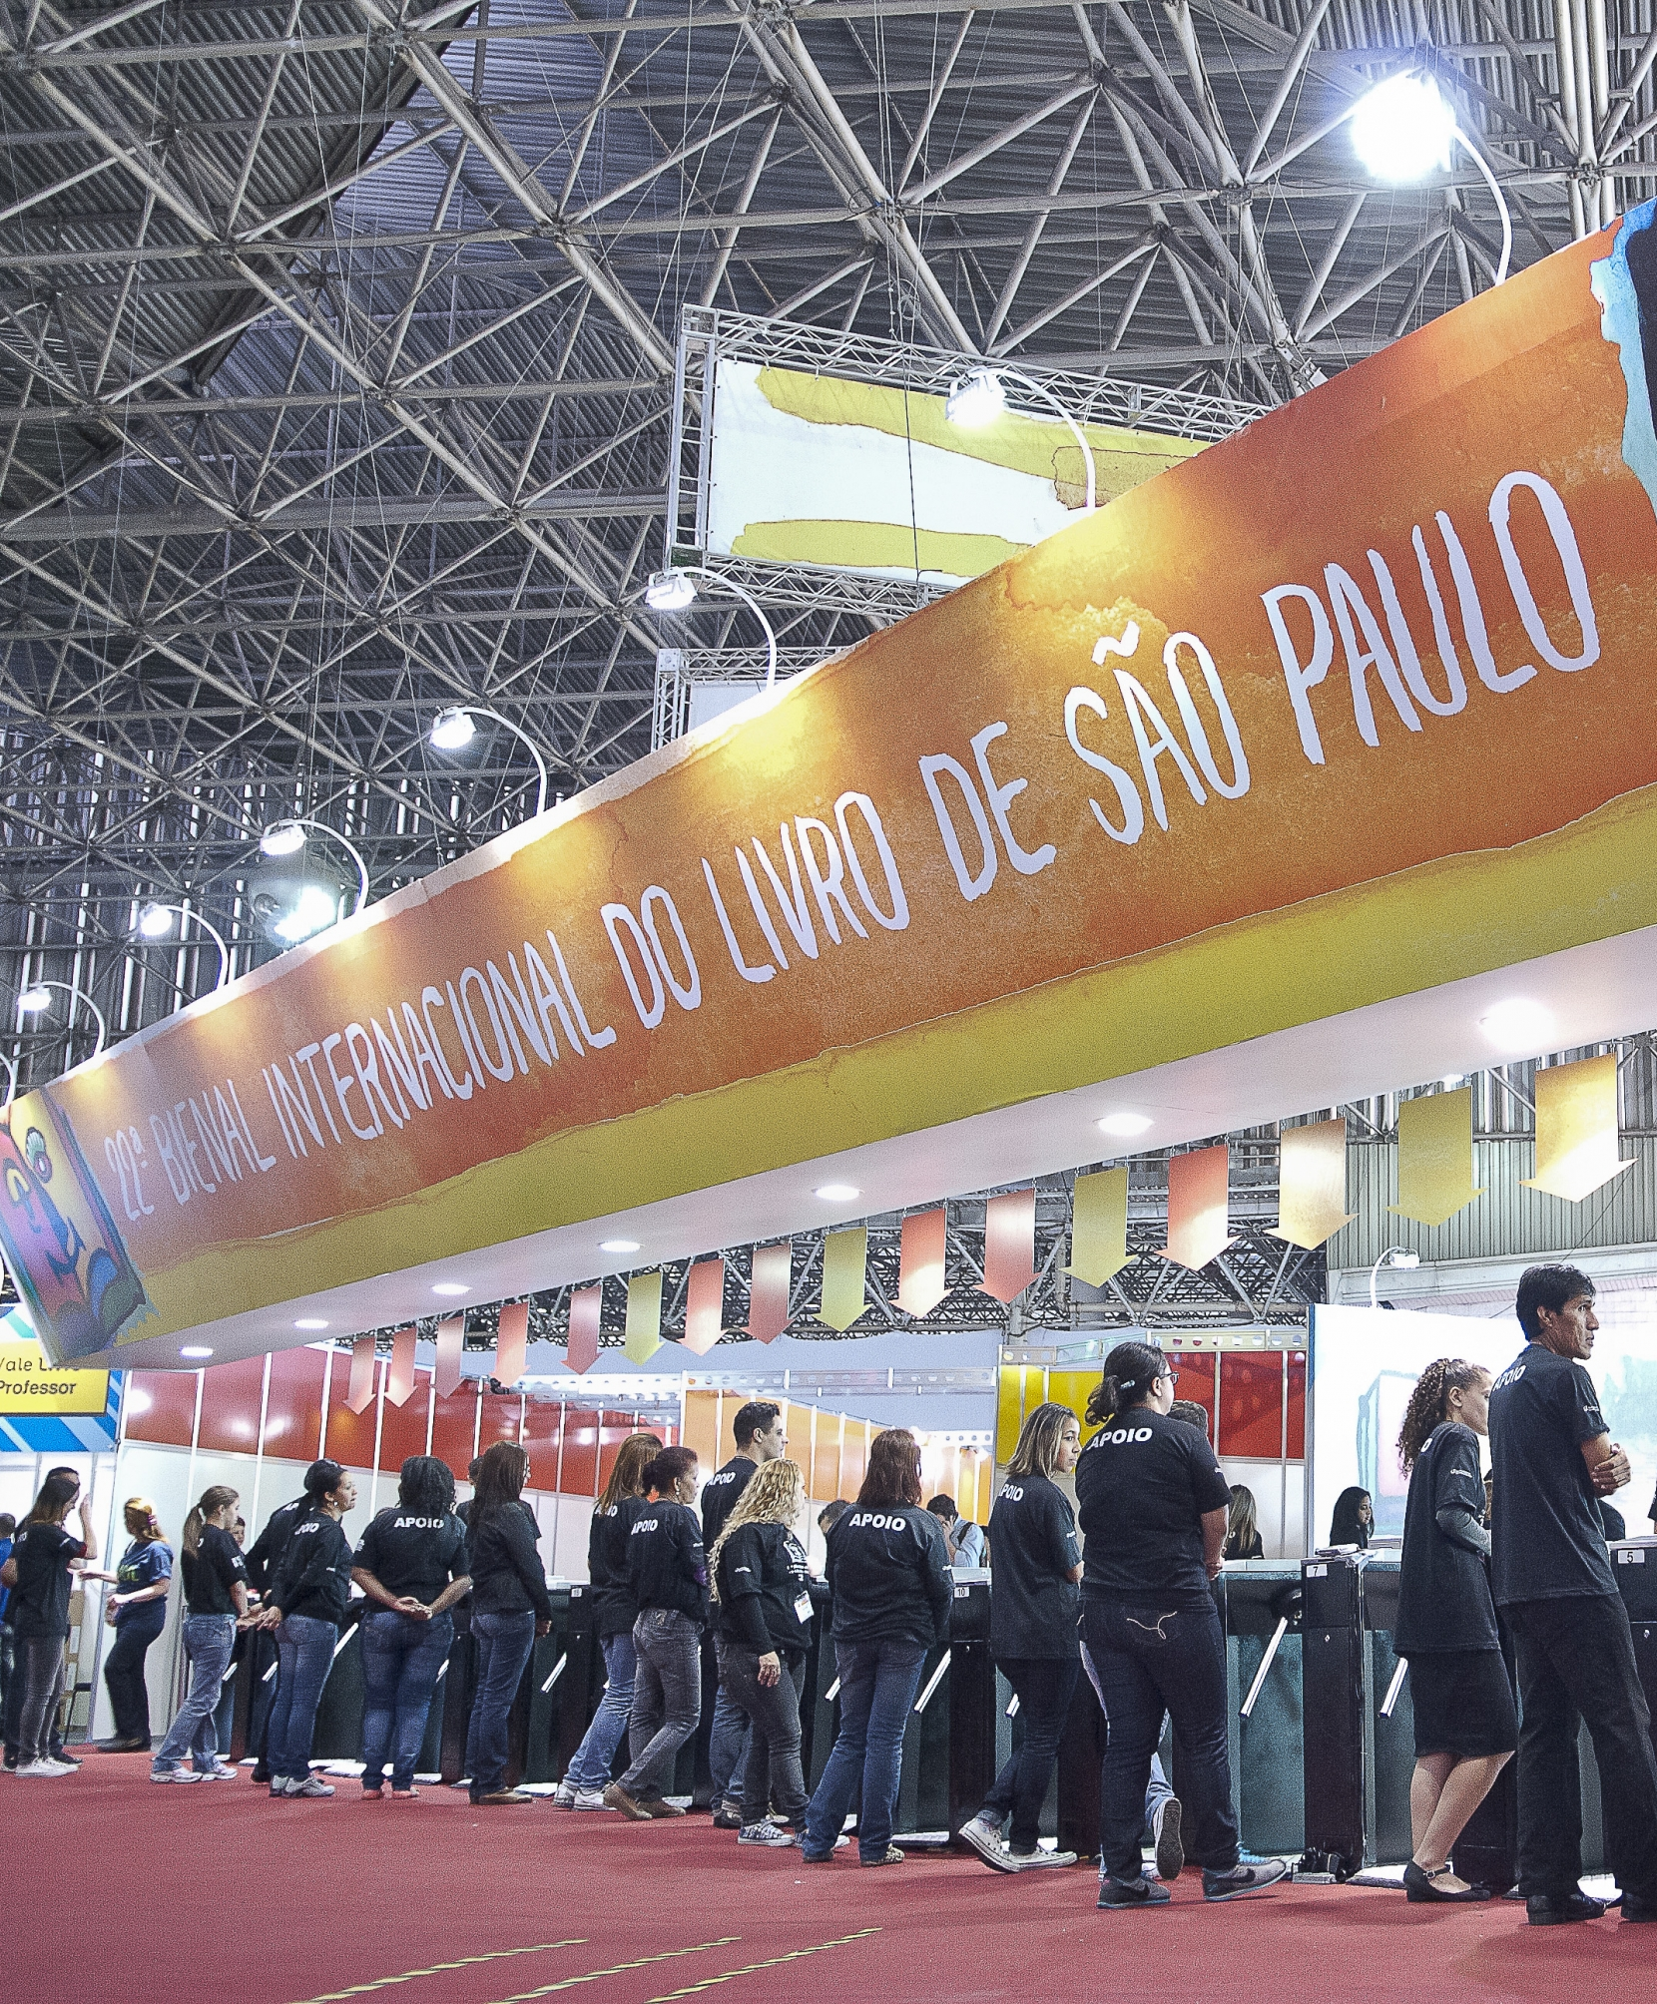
São Paulo International
Book Fair
July 2nd – 10th
The largest literary event in Latin America. It gathers the main publishing houses, bookstores and distributors of the country that present their products and releases.
The Book Fair takes 700 thousand visitors and offers an extensive cultural program, mixing literature, gastronomy, culture, business and meetings of writers with their audiences.
Visit Us

Slide 6
Professional Days
During the event, business rounds sessions between national and international players take place.
The project, which is in its third edition, has the goal of expanding the national publishing market. In 2020, the Professional Days generated USD 128,000 in business for participating publishers.
June 29th – July 1st
This year, the São Paulo International Book Fair
will happen in a hybrid format, in July.
The applications for the Professional Days will be open soon!

Slide 7
Jabuti Award
The most important book award in Brazil.
Last year, the award reached its 63rd edition and happened online. The curator council is joined by specialists and professionals from multiple areas of knowledge and led by a master curator.
There are 20 categories in the award, and the most awaited one is the Book of the year.
The international market is celebrated through the “Brazilian Book Published Abroad” category, which was created in 2017 and promoted by Brazilian Publishers.

Slide 8
Brazilian Publishers
Created in 2008, the initiative aims to promote the Brazilian publishing industry in the global market in an articulate and well-directed manner, contributing to the professionalization of the publishing houses.
The program is a result of a partnership between the Brazilian Book Chamber and the Brazilian Trade and Investment Promotion Agency (ApexBrasil) and has 58 publishers participating in its initiatives.

Slide 9
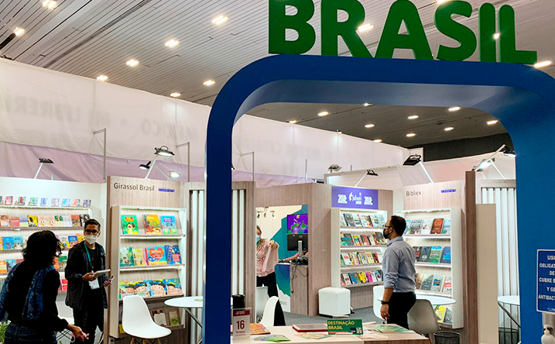
Brazilian Publishers fosters exports through promotional activities to improve the sales of publishing rights, including:
The Brazilian participation at international trade shows and events.
Invitation to international professionals to visit Brazil and do business, such as the Professional Days.
The production of a Brazilian book and rights catalogue to promote the books abroad.
Brazilian Publishers Translation Grant and more!

Slide 10
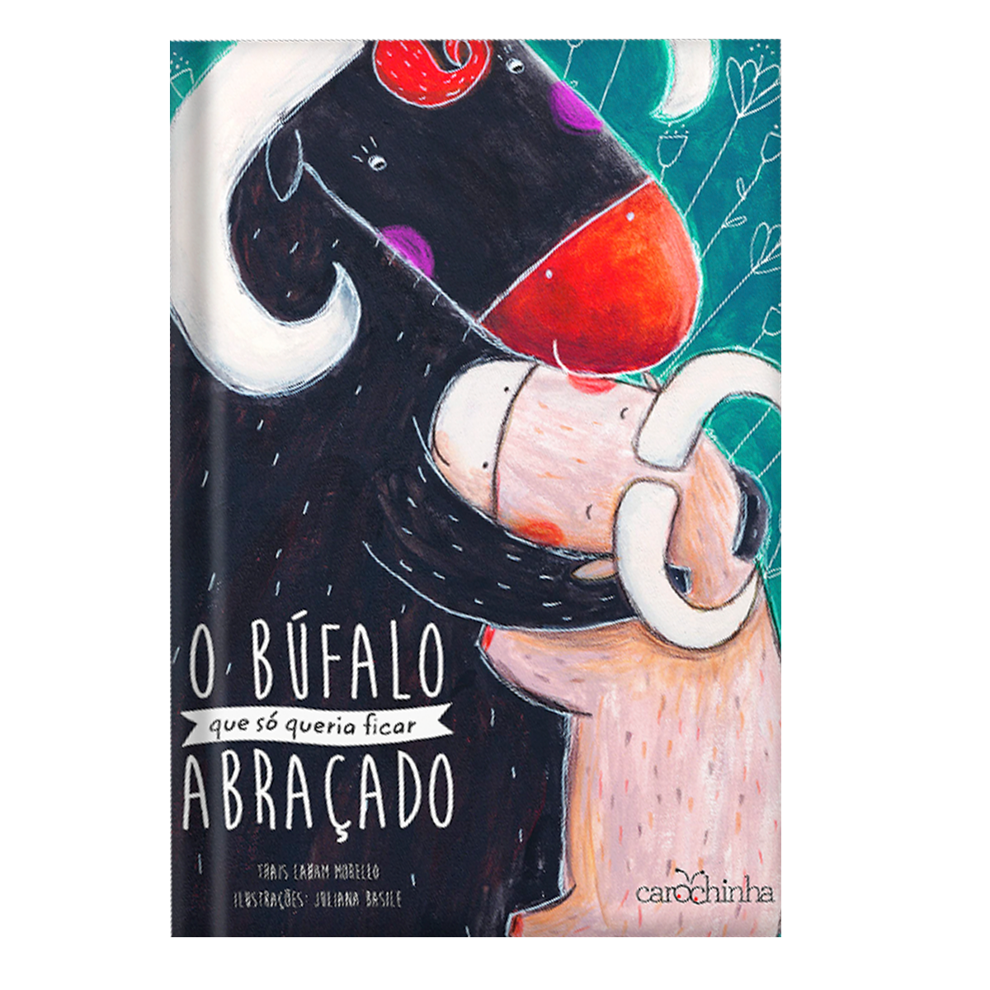
Brazilian Publishers Translation Grant
Support for translations of Brazilian books into any language. The Program may benefit publishers with projects into the following support forms:
Rights:
Original translations: never-before published in the foreign country
New Translations: already translated works in need of new one due to ephemeris, tribute or updates
Physical books
Reissue of Brazilian works already translated in the foreign country, but out of print and out the market for at least three years

Slide 11
Since its creation, in 2019, the grant has already supported more them 20 Brazilian works.
Discover the languages ​​into which the Brazilian books have been translated:
Spanish
Arabic
French
Serbian
Slovak language
Sena, Macua and Changana
Visit Us
Learn more about the books that have already hit the shelves on the next slide!

Slide 12
Brazilian publisher
International publisher
Country
O governador do sertão
Editora Jaguatirica
Abismos Casa Editorial
Mexico
Com que roupa irei à festa do rei
Editora do Brasil
Gerbera Ediciones
Argentina
Rio em seis tempos
Editora Jaguatirica
Abismos Casa Editorial
Mexico
O vale dos mortos
Faro Editorial
Círculo de Lectores
Colombia
O garoto quase atropelado
Faro Editorial
Círculo de Lectores
Colombia
Companhia das Letras
Al Arabi Publishing and Distributing
Egypt
As perguntas
Companhia das Letras
Al Arabi Publishing and Distributing
Egypt
Dias perfeitos
Suicidas
Companhia das Letras
Al Arabi Publishing and Distributing
Egypt
Tropical sol da liberdade
Companhia das Letras
Al Arabi Publishing and Distributing
Egypt
Em um lugar do mundo
Editora do Brasil
Gerbera Ediciones
Argentina

Slide 13
THE BRAZILIAN PUBLISHING MARKET

Slide 14
Readers
In Brazil, there are about 100 million readers, who make up 52% ​​of the population.
Readers
Non-readers
Visit Us
Millions
Source: Pesquisa Retratos da Leitura no Brasil (2020)

Slide 15
Visit Us
Who is the Brazilian reader?
Most of them are women, white people, and at school-age.
59% of them are women
55% of the readers are white
Most are between 11 and 17 years old
Source: Pesquisa Retratos da Leitura no Brasil (2020)

Slide 16
In the most popular genres among Brazilians, the following stand out:
1. The Bible
9,400+
3. Religious
INFORMATIONS
2. Short story
4. Novels
Interactively procrastinate high-pay off content without.
5. Educational
7. Children's
8. History, Economics, Politics, Philosophy or Social Sciences
INFORMATIONS
6. Poetry
Interactively procrastinate high-pay off content without.
*It is important to point out that the study that resulted in this data was carried out before the pandemic. Today, we know that there has been a growth in the sale of children's books and general works during the period.

Slide 17
Sales
A striking feature of the Brazilian market is the great importance of book sales to the government.
TOTAL
MARKET
GOVERMENT
354 MILLION
193 MILLION
161 MILLION
COPIES
5,2 BILLION
3,7 BILLION
1,4 BILLION
TURNOVER
(BRL)
Production and sales of the Brazilian Editorial Sector | Source: Nielsen Book

Slide 18
Production
In 2020, the editorial sector produced 314 million copies.
The vast majority of titles published annually in Brazil are reprints. The low bibliodiversity is an important issue for the market.
82%
REPRINTS
18%
NEW TITLES
Production and sales of the Brazilian Editorial Sector | Source: Nielsen Book

Slide 19
Production
The Brazilian publishing sector has 4 major subsectors:
Copies produced in 2020 by subsector
EDUCATIONAL
12,273
GENERAL WORKS
21,599
General works hold the vast majority of the market share. Within this subsector, children's books stand out: in 2020, Brazil produced more than 16,000 copies.
RELIGIOUS
4,976
STM
7,534
(in thousands)
Production and sales of the Brazilian Editorial Sector | Source: Nielsen Book

Slide 20
Sales by channel
Distribution channels
COPIES
TURNOVER
BOOKSTORES
29%
30%
Bookstores, both physical and virtual, are the main distribution channels in the Brazilian market
VIRTUAL BOOK STORES
28%
25%
DISTRIBUTORS
16%
19%
SCHOOLS AND COLLEGES
6%
9%
MARKETPLACES
3%
8%
CHURCHES AND TEMPLES
5%
2%
DOOR-2-DOOR AND CATALOGUE
4%
2%
OTHERS
10%
5%

Slide 21
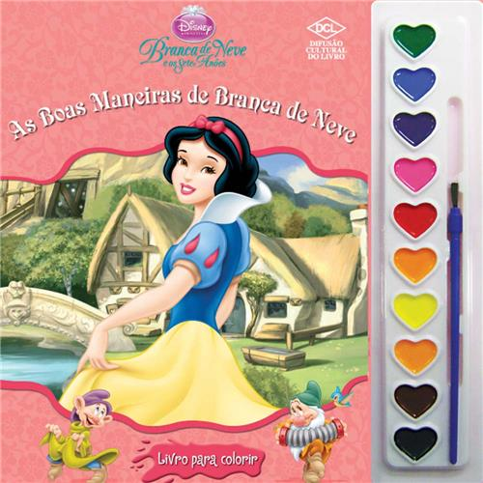
Co-editions
Brazilian publishers are most likely to participate in co-editions. Our publishing houses rarely organize one.
The most coveted edition types are:
Toy books
Four-color coffee table books
Pop up books

Slide 22
Why do Brazilian entrepreneurs look for co-editions?
Obstacles for closing partnerships
The print runs are low
The graphics industry is not competitive
Brazilians have the technique and know-how to make some types of books
Real devaluation
Unpredictable exchange rate (economic forecasts for 2022 and 2023 are not good)
High interest rate

Slide 23
RIGHTS

Slide 24
Rights
Brazilian books by contemporary and classic authors have drawn attention in the foreign market. Brazilian publishers are used to both selling and buying rights and are quite involved in this market. The practices do not diverge from the usual.
Visit Us
In 2021, the 58 publishing houses participating in Brazilian Publishers alone ended the year with USD 450,000 in rights negotiated with the international market.

Slide 25
Crooked Plough
The book has been a sales phenomenon in Brazil, with more than 165,000 physical and digital copies sold since its launch in 2019.
The title had its rights sold to Italy, Mexico, Peru, Slovakia, Bulgaria, Croatia, France, Germany and United States. It will soon also become a television show in Brazil.
“
The success is based on the fact that, in addition to its profound literary beauty and Itamar’s beautiful writing, it is a story that strikes the reader by showing the insides of Brazil.”
Ricardo Sánchez Riancho, founder and CEO of Textofilia.

Slide 26
My Sweet Orange Tree
Published in Brazil in 1968, the book has more than 115 registered translations, for languages ​​such as Spanish, Korean, Chinese, Polish, German, Turkish, Japanese, Croatian, Catalan, Romanian, Danish, and Thai. The title is celebrated in South Korea, it has already been launched by two publishers in the country and is a required reading in Korean schools for children.
My Sweet Orange Tree has three adaptations for soup operas (1970, 1980 and 1998) and two for the movies (2013), in addition to several for the theater.
Source: Publishnews

Slide 27
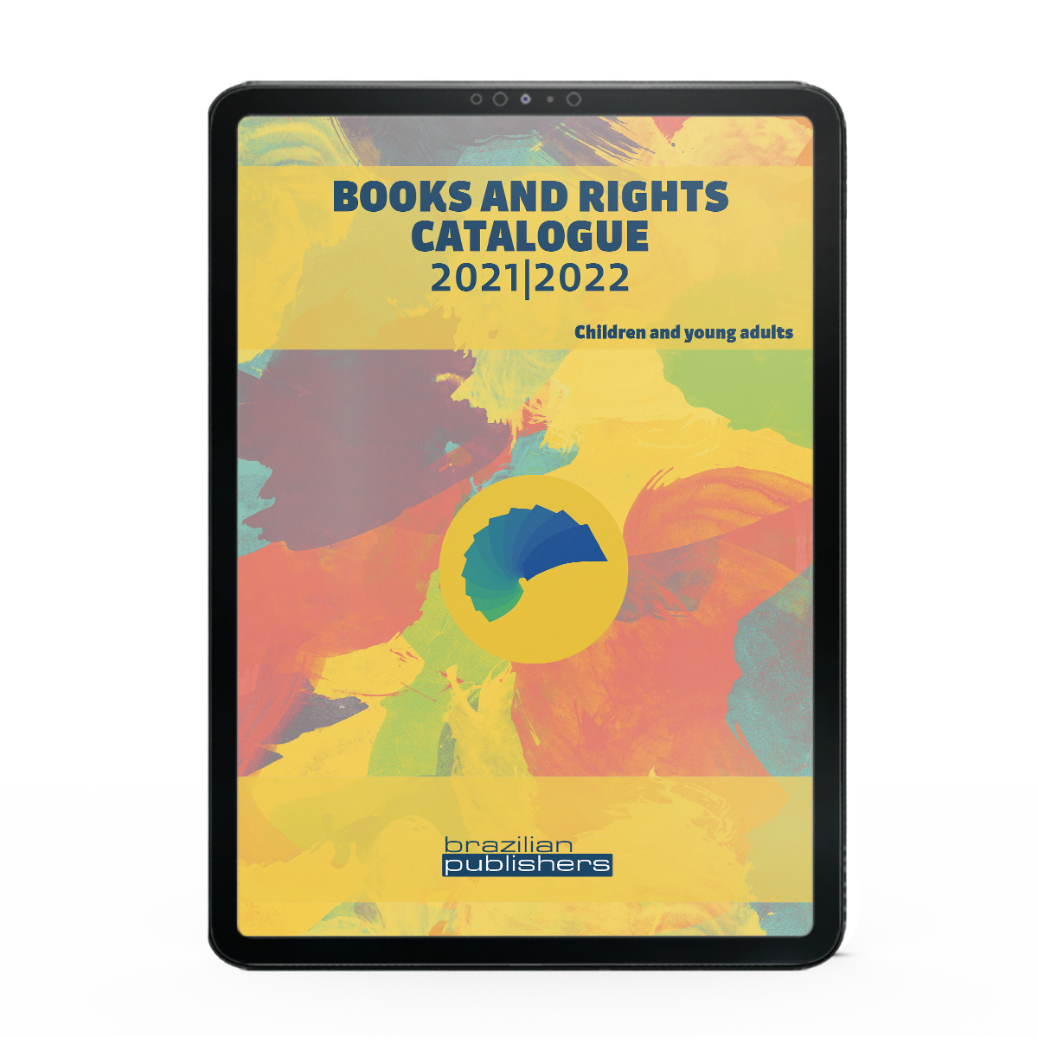
Brazilian Books and Rights Catalogue
In addition to other initiatives, Brazilian Publishers promotes the sales of Brazilian rights in the foreign market through its books and rights catalogues. The material is available in English, and Spanish. Last year, the launch was carried out through three catalogues:
Children and Young Adult books, which brings together titles from 25 publishers;
Fiction and Non-Fiction books, including books from eight publishers;
STM, Academic and Religious books, also featuring the works of eight publishers.

Slide 28
SDG Book Club Portuguese Language — Brazilian Chapter
The SDG Book Club is a project created by the UN with the support of the IPA that aims to use books as tools to encourage children to get in touch with principles of the UN Sustainable Development Goals.
In Brazil, the project began in 2020 and selected 175 Brazilian literary works, that can be found in the catalogue supported by the Brazilian Publishers.
Available in Portuguese and English.
Divided into 17 chapters, specific to each objective.
Has a list with the names of writers, illustrators, translators and editors.
Versions in PDF and ePub format.
There are 20 categories in the award, and the most awaited one is the Book of the year.
The international market is celebrated through the “Brazilian Book Published Abroad” category, which was created in 2017 and promoted by Brazilian Publishers.
clubedeleituraods.com.br

Slide 29
Brazil at Pubmatch
Another Brazilian Publishers initiative to promote the sale of rights is the organization of Brazilian Publishing houses books with rights available to the market in PubMatch. The website is a global hub for the book chain, focusing on buying and selling rights. Brazil gained a dedicated page, with more than 465 books registered, from 52 publishers.
https://www.pubmatch.com/brazilianpublisher

Slide 30
Thank You!
See you in Bologna and London!
fernandadantas@cbl.org.br
Fernanda Dantas
International relations manager at CBL and executive manager at Brazilian Publishers fernandadantas@cbl.org.br

