Slide 1
Livres Canada Books Mentoring Program
Colombia 2022-2023
Webinar presented by Luis Fernando Páez
March 1st, 2023

Slide 2
Luis Fernando Páez
Colombian Editor and Publisher
15+ years of experience
Editorial Norma (2006-2013)
Hipertexto (2013-2015)
Editorial Planeta (2015-2022)
Non Fiction (Academic, Business, Current Affairs, Politics, Economy, History, Journalism, Essays, General Interest)
Literary Studies BA, Journalism BA, MBA
Digital Marketing and Interpersonal Communication
London Book Fair; BEA (NY); Guadalajara; FilBo

Slide 3
Now, let me know you better.

Slide 4
How is Colombia today?
Some context
Post-pandemic economy, recession, inflation and unemployment on the rise
Low levels of bilingualism (English)
Low levels of book sales* and reading
The first left-wing government in Colombia took office in August 2022 and arrived with an agenda of changes and reforms after the social outbreak of 2022-2023 with the consequent polarization of society. Among their proposals:
"Deprivatization" of services and greater state intervention.
Energy transition: move from the hydrocarbon-based model to the renewable energy model and mitigate the impact of global warming. Public policies for the care of the Amazon.
Government with a strong tendency to be autocratic
High migration of Venezuelans: Colombia is the country that has received the largest flow of Venezuelan refugees and migrants in the world, close to 3 million. Despite the opening of the border with Venezuela after its closure in 2015 and the reestablishment of commercial relations, the population does not seem to return to their homeland.
Colombia is a "country at peace" after a negotiation with the FARC and the signing of a peace agreement in 2016, but violence has not stopped due to the emergence of dissidents and other groups. This has led to proposing a government policy of "total peace" with other armed groups (ELN) or criminal groups that have expressed their willingness to lay down their weapons.
There is an emphasis on policies for young people who do not work and do not study; aids for the elderly who do not have a pension. A society with great inequalities.
Elections of local leaders in October who take office in January 2024.

Slide 5
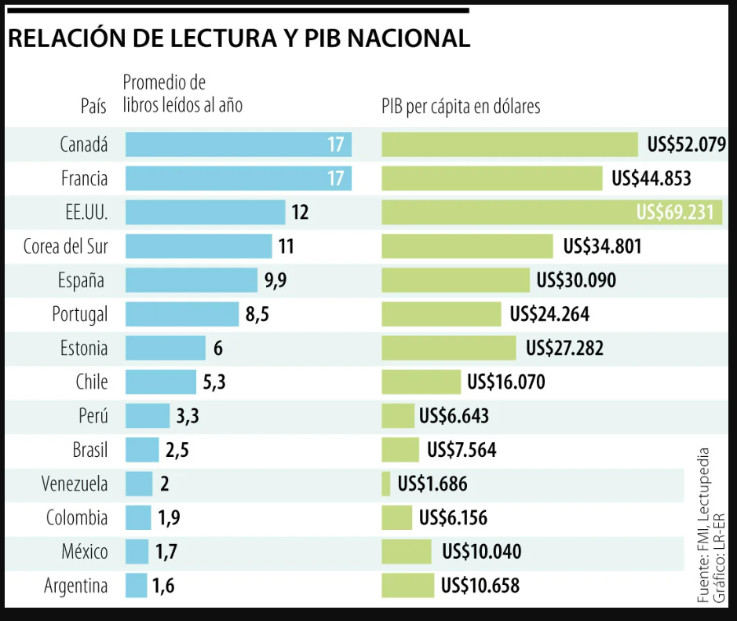
How is Colombia today?
Some context

Slide 6
The Colombian Book Environment
Some context
Two dominant groups
Emergence of independent publishers with their own distributor
Academic and university publishers
Scientific and technical publishers
Self-publishing models
Negotiation of editorial rights and contracts
Number of new releases per year

Slide 7
The Colombian Book Environment
Some context
Bookstores: two main chains and several new independent bookstores
Retailers that sell books
Online bookstores
Colombian Book Chamber, Filbo 2023 and Filbo 2024
Regional book fairs
Books in the media: TV, radio, press, magazines, digital

Slide 8
The Colombian Book Market
The pandemic, the consumption of books and reading
The pandemic and the shortage of supplies
Costs and prices
Formats
Sales behaviour – Bestsellers - Nielsen
Booktubers, influencers and book marketing
Piracy
Book consumer profile
Colombian publisher profile
Strengths
Weaknesses
Opportunities
Threats

Slide 9
Challenges for Canadian Publishers
Get known by local publishers and draw attention to your product
Generate demand and appetite for your books with local booksellers and publishers
Create long or medium-term relationships with local publishers
Overcome the cost barrier of translations through the use by Colombian publishers of Canadian government aid for the translation of Canadian authors
Create ties with Spanish agencies that represent your catalogs and offer your publications to Colombian publishers at fairs or have an agent on the ground

Slide 10
Q&A
Please type your questions in the Q&A panel

Slide 11
Thank you

Slide 12

To watch videos of our previous webinars, visit our website:
https://www.livrescanadabooks.com/Webinar-Archive/
Livres Canada Books respectfully acknowledges that our offices are located on the traditional, unceded territories of the Algonquin nation.
Livres Canada Books reconnaît respectueusement que ses bureaux sont situés sur les territoires traditionnels non cédés de la nation algonquine.

