Slide 1
Exporting to Slovenia
Webinar presented by: Mihael Kovač
Thursday, August 17, 2023

Slide 2
Topics of the day: Slovenia and Book publishing
the state of publishing, distribution, and retail
licensing, translation, and audio rights
co-editions
reading and book buying habits
market trends and key players
the ebook and audiobook markets
and much more!

Slide 3

But first of all….what the heck is Slovenia?

Slide 4
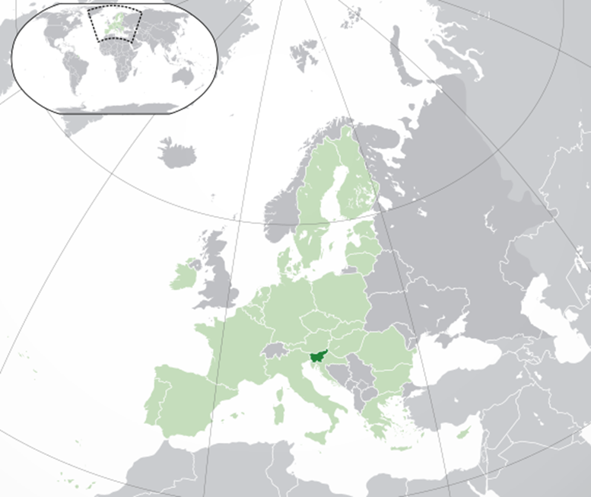
It’s small.

Slide 5
Basic info
Two million inhabitants
EU and NATO member since 2004, in euro zone since 2007
GDP approx. 30,000 per capita, (34th place on IMF list, between South Korea and Czech Republic)
No.7 in Global Peace Index (between Portugal and Czech Republic)
No.22 in World Hapiness Report (between France and Costa Rica)
No.33 in Global Innovation Index (between Portugal and Hungary)
It’s one of the greenest countries in the world (60% of the territory is covered in forests)
Notes:
GPI, the largest deteriorations were recorded in neighbouring country relations, intensity of internal conflict, refugees and IDPs, political terror scale and political instability.

Slide 6
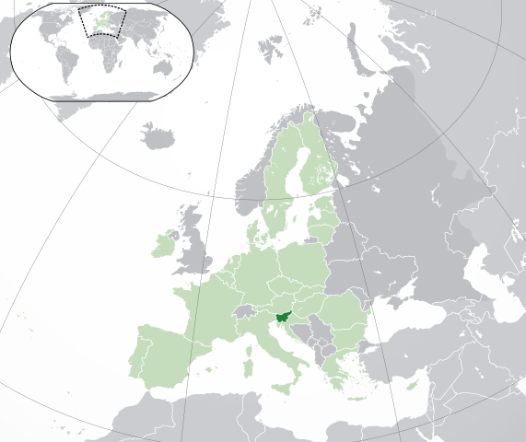
It’s in a great place.

Slide 7
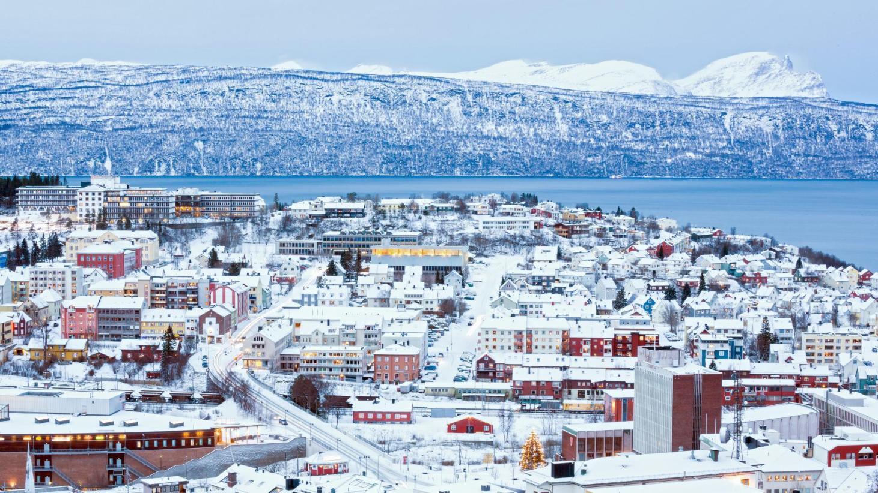
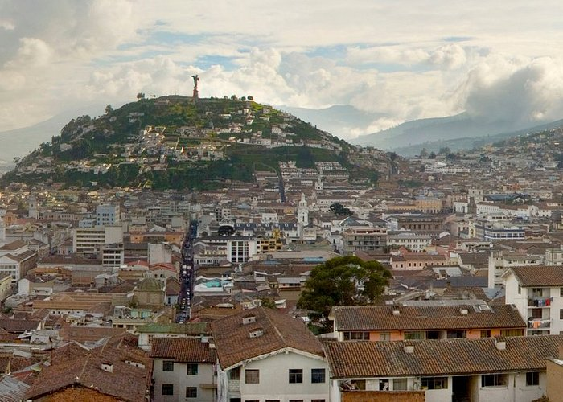
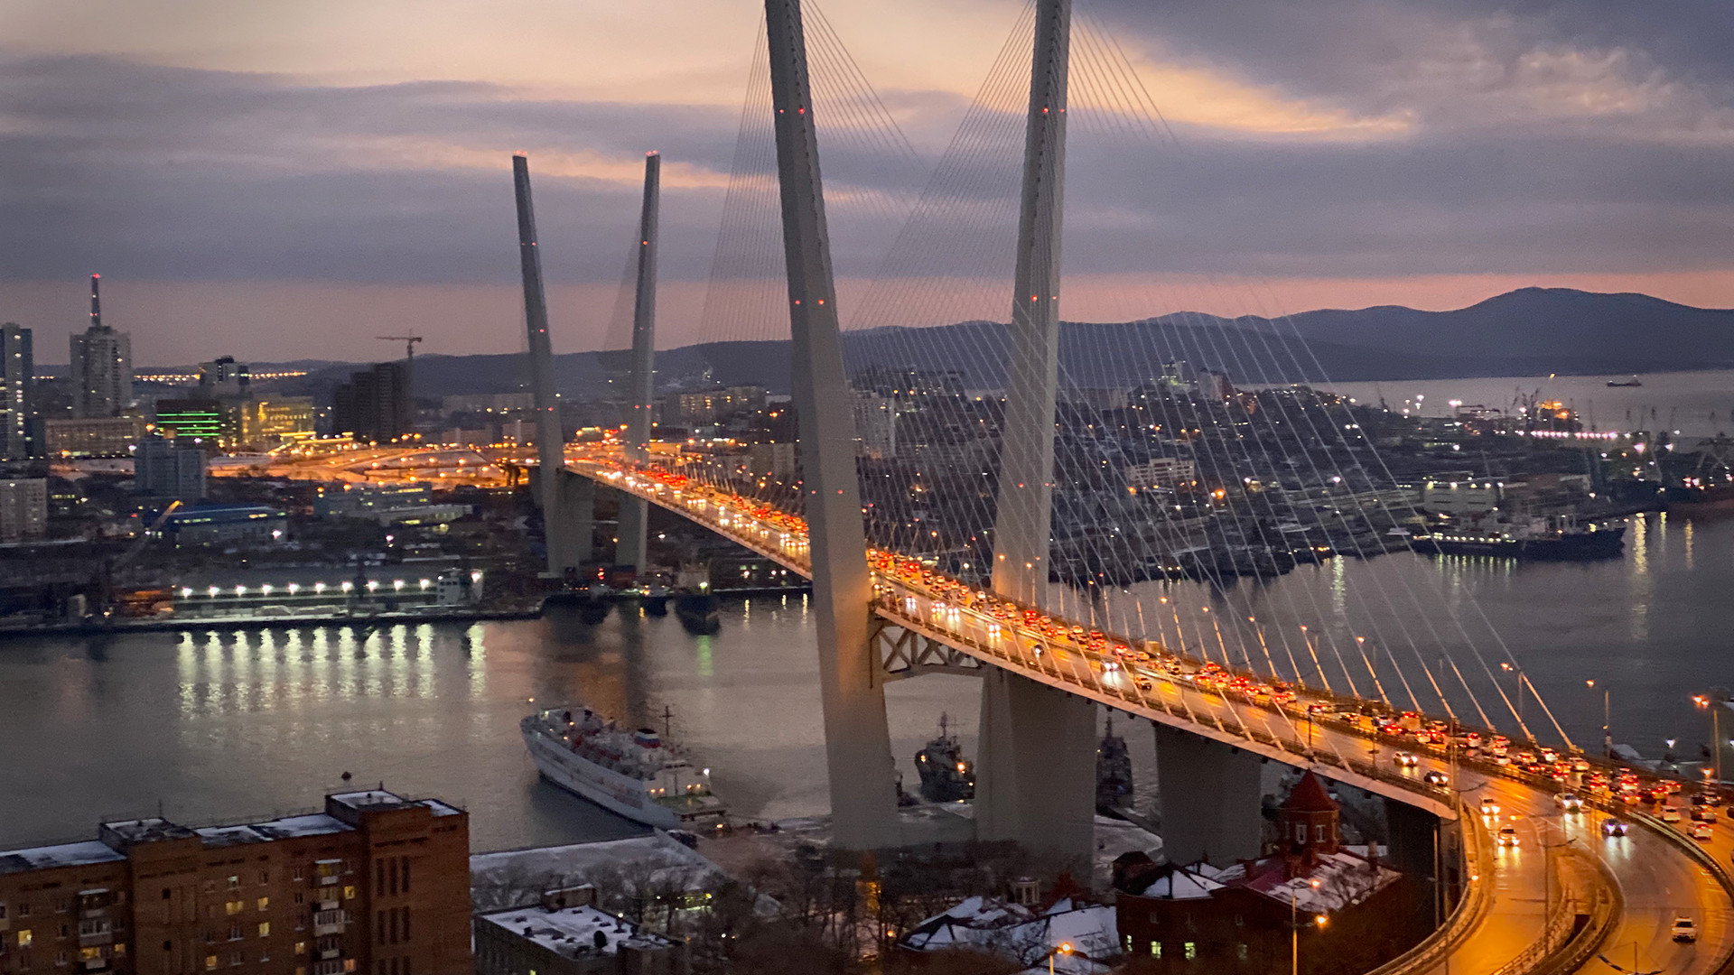
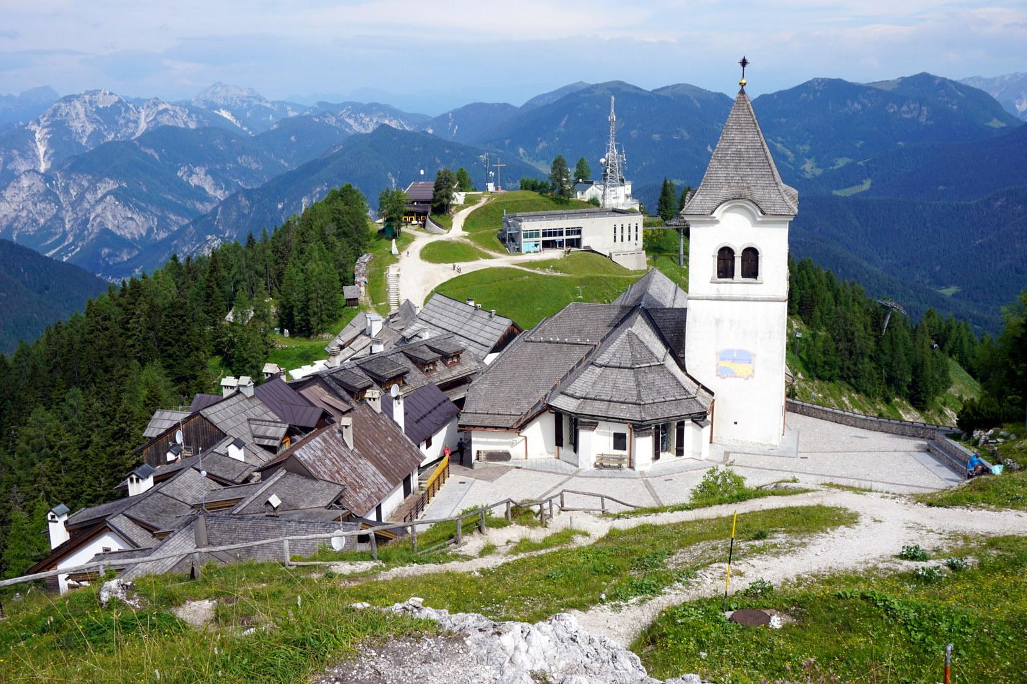
It’s in a crossroad of languages and cultures...

Slide 8
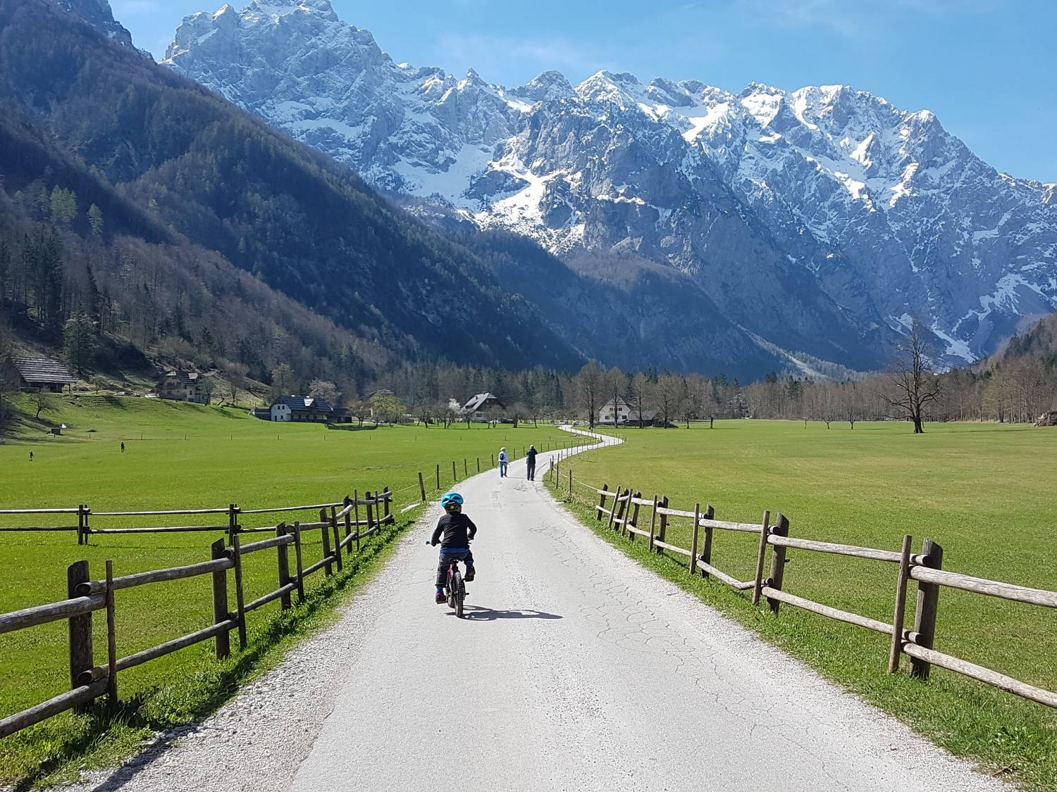
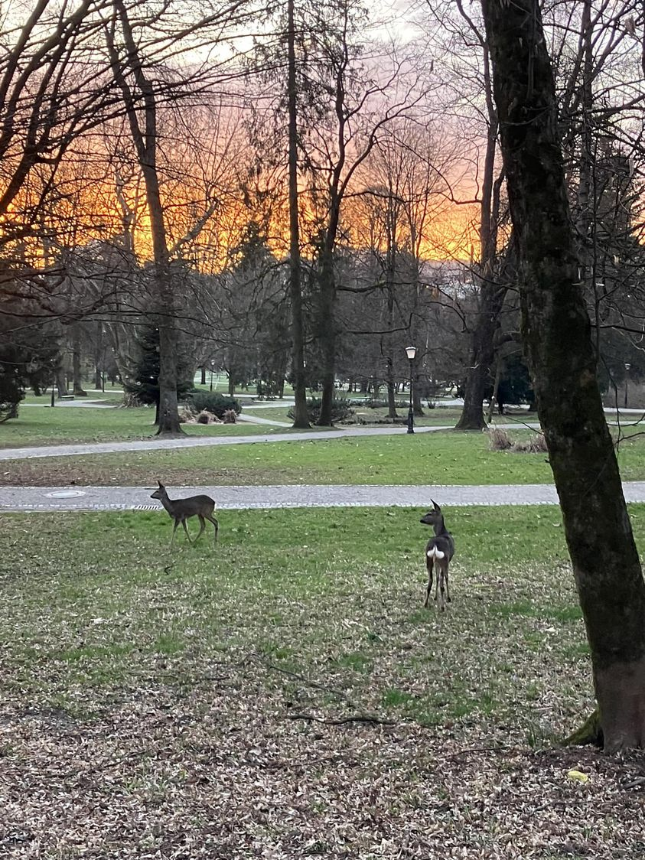

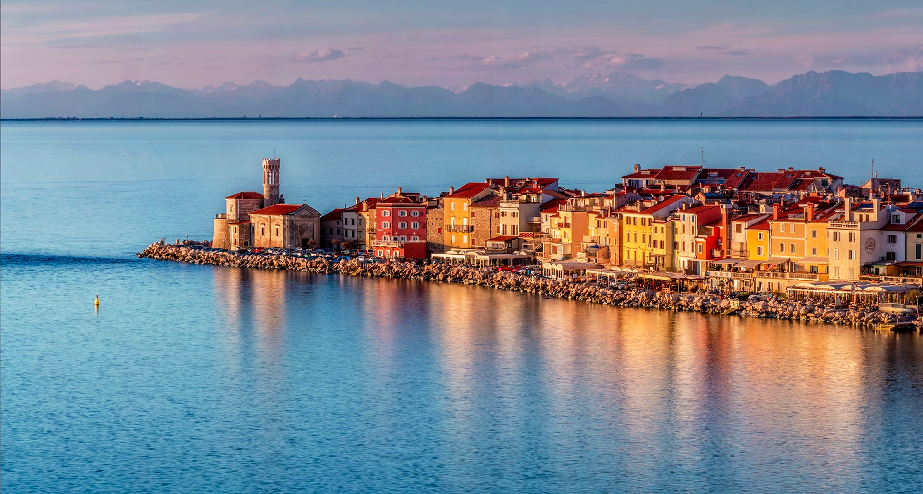
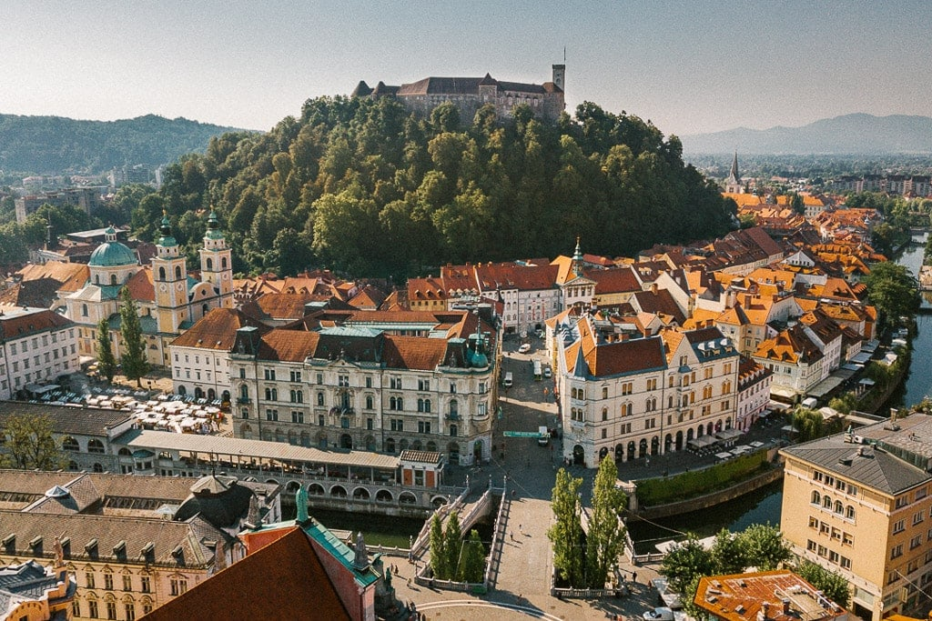

... and landscapes....

Slide 9





… and failed states….

Slide 10
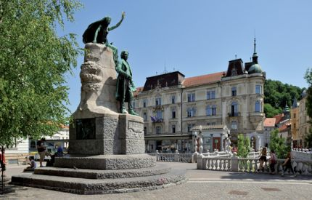
In such a windy place, culture and public life were one of the main pillars of identity.

Slide 11
Slovenian book market structure
As all small book markets, the Slovenian book market is vertically integrated (publishers own book stores or vice versa).
There are only a few bookstores that sell only books.
Some publishers are involved in other businesses (for example, the biggest Slovenian religious publisher also runs a tourist agency).
Consequently, there is no exact data on the entire book market, just educated guesses.

Slide 12
Basics about Slovenian book market
Number of published titles in 2022: approx. 5000 ISBNs issued , around 3,300 titles or sales on the consumer market (1.6 titles per 1000 inhabitants).
Number of publishers: 80 members of Slovene PA, 65 of them published more than 10 book titles in 2022.
Turnover: approx. 65 MM euros, of which around 15-17 MM euros in educational market.
Number of printed copies: approx. 4.5 MM.

Slide 13
Basics 2
Average price of newly published title: approx. 21 euros.
Average price of a title sold in bookstore chains: approx. 12 euros (depending on chain).
Ebooks and audiobooks are less than 1%.

Slide 14
Slovenian trade book market by language
English books very likely represent additional 15-20% sales on Slovenian book market. These sales are only partially measurable, yet according to the data from the biggest bookstore chain, English is becoming a serious competition in some genres.
As with any small market, Slovenian book market is heavily translation-dependent.

Slide 15
Books in English
In reading population, the 18-24 year-old age group , 85% of readers read in Slovene and English, followed by 62% in 25-34 age group and 39% in 35-49 age group .
The English language books represent large competition to the translations → their prices are lower, and they are available earlier.

Slide 16
Trade books by origination language
Origination language | 1990 | 2000 | 2010 | 2020
Books written in Slovenian | 249 | 446 | 731 | 1072
English translations | 102 | 116 | 397 | 409
German translations | 23 | 37 | 68 | 63
French translations | 15 | 18 | 40 | 52
Italian translations | 4 | 5 | 34 | 27
Spanish and Portuguese translations | 3 | 9 | 18 | 21
Russian translations | 4 | 5 | 7 | 10
Polish translations | 3 | 2 | 11 | 9
Transaltions from South Slavic languages | 7 | 12 | 31 | 33

Slide 17
Biggest players on the market
Mladinska knjiga group in trade publishing (around 40% in trade and more than 60% in bookselling)
Rokus Klett in educational publishing (around 50% in educational)
Ebooks: 1 to 2% in trade, audio is still non-existent, educational publishing heavily digitized

Slide 18
Biggest players on the market
Mladinska knjiga = Amazon + Penguin Random House + Barnes and Noble under one roof.

Slide 19
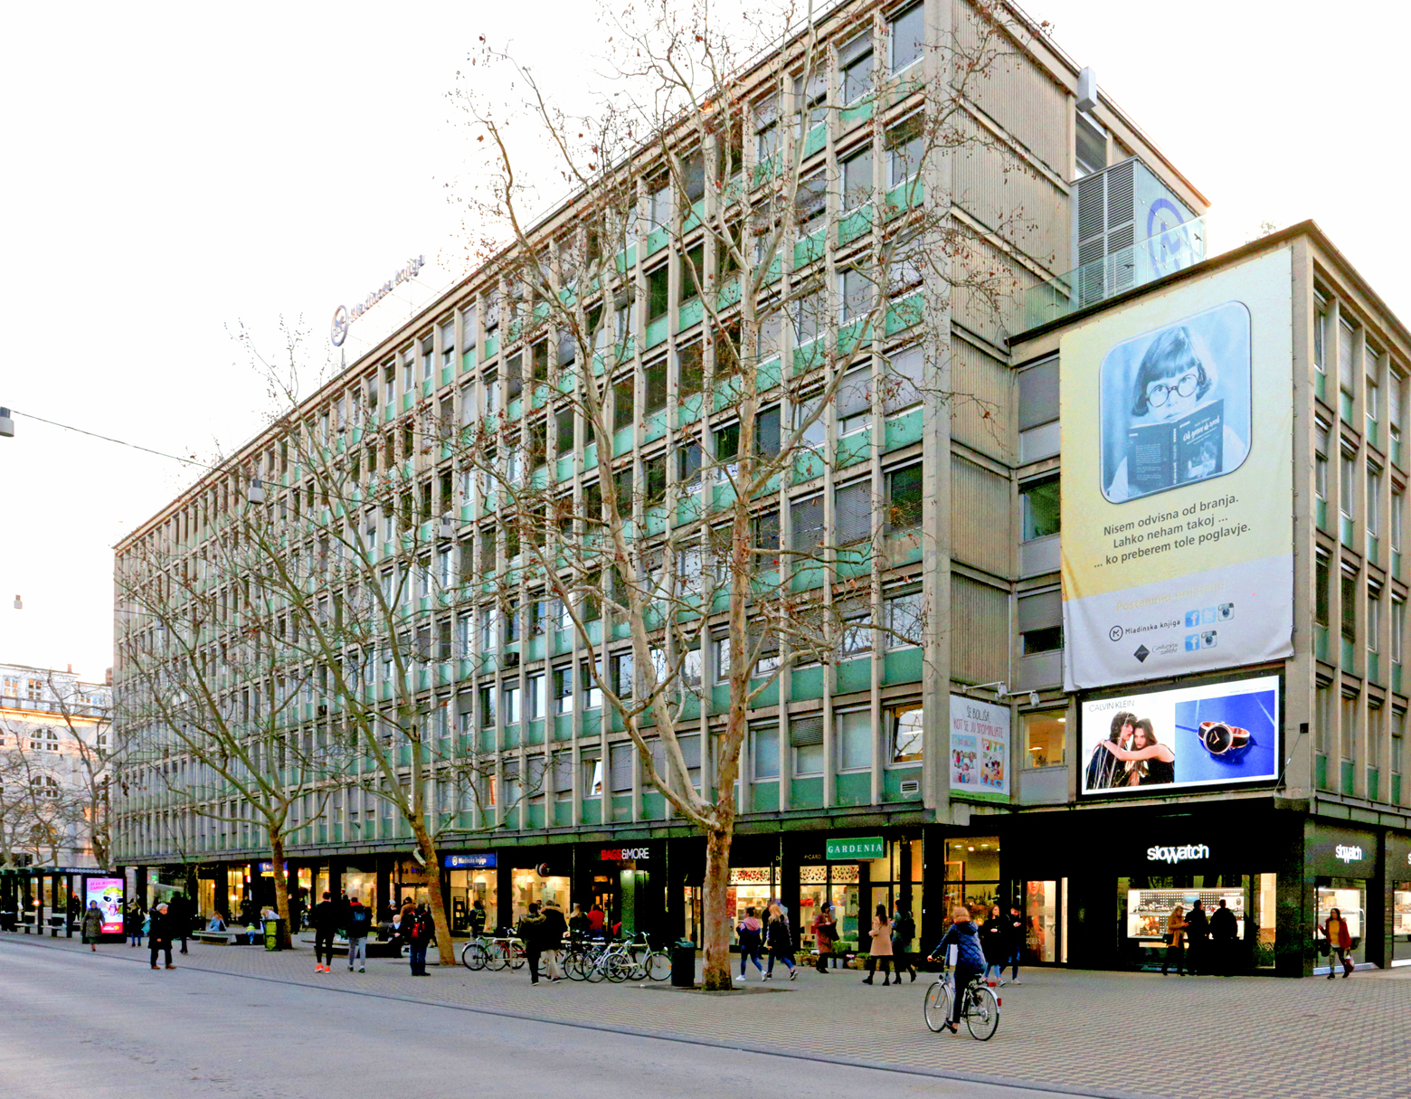

Slide 20
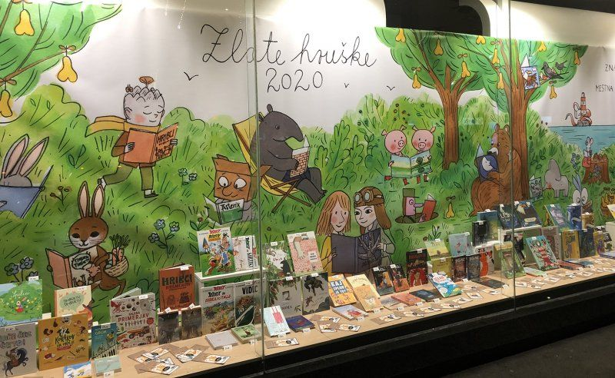

Slide 21
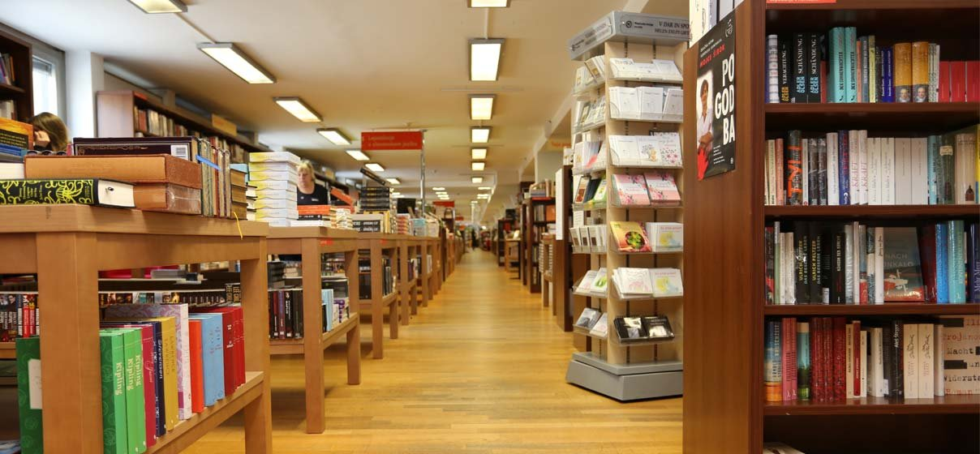

Slide 22
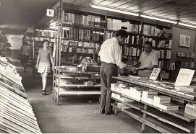

Slide 23
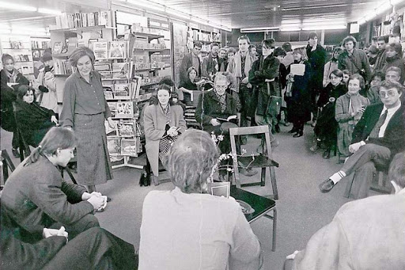

Slide 24
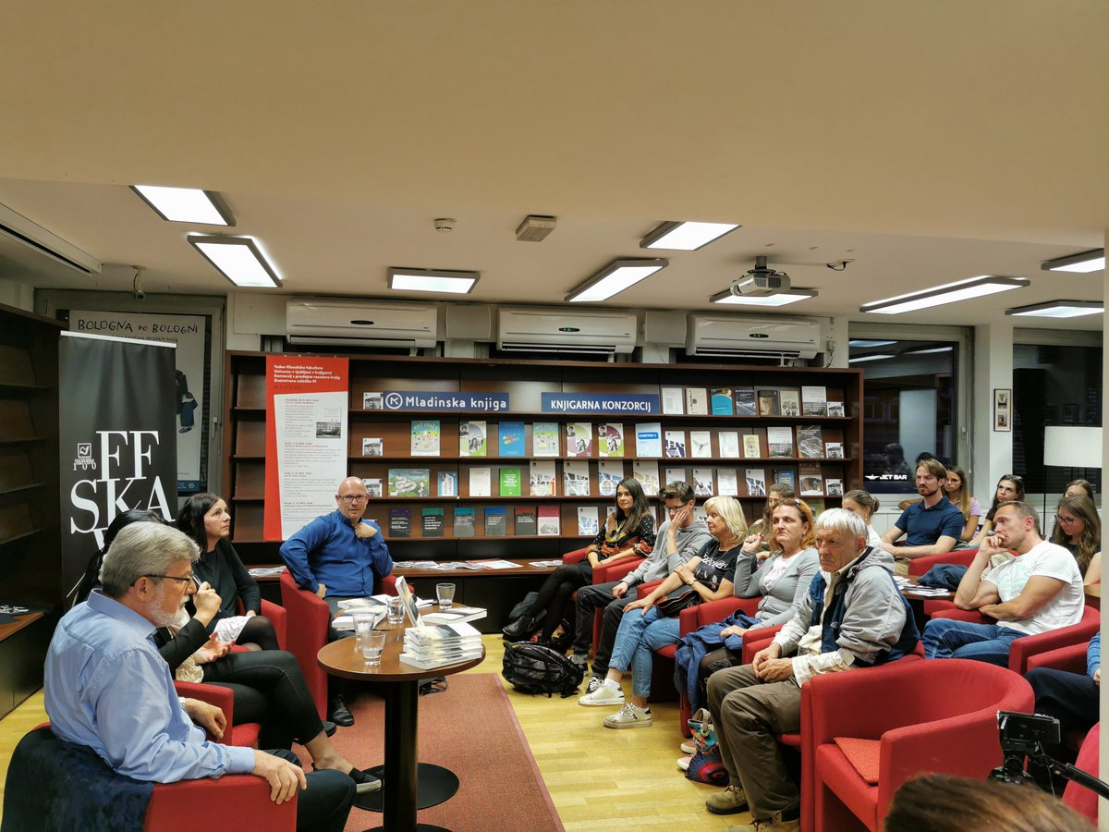

Slide 25
The main bookish event: Slovenian book fair
The fair takes place in Ljubljana in the last week of November. The fair is B2C and also a kind of a literary festival.
Number of visitors: 45,000 (almost the same as the number of visitors at the Vienna book fair, but Vienna is about five times bigger than Ljubljana).
Number of Book Fair events: 200-300.
Estimated turnover in book sales: approx. 2 MM euros.

Slide 26
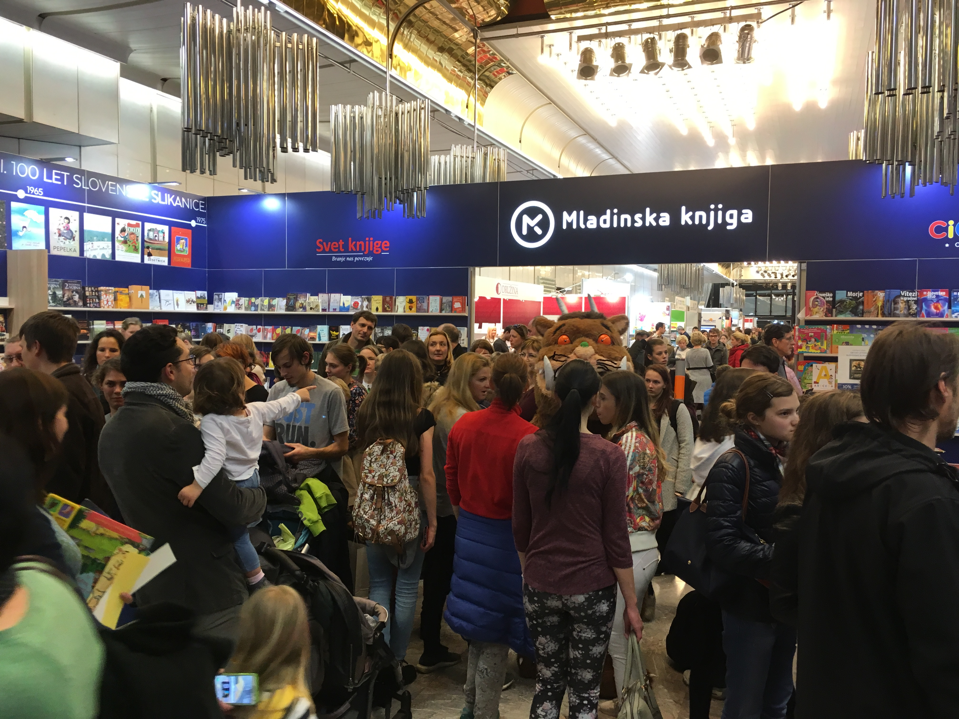

Slide 27
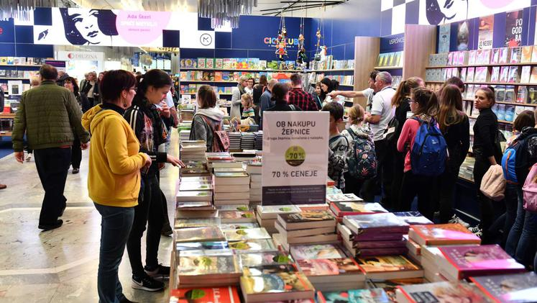

Slide 28
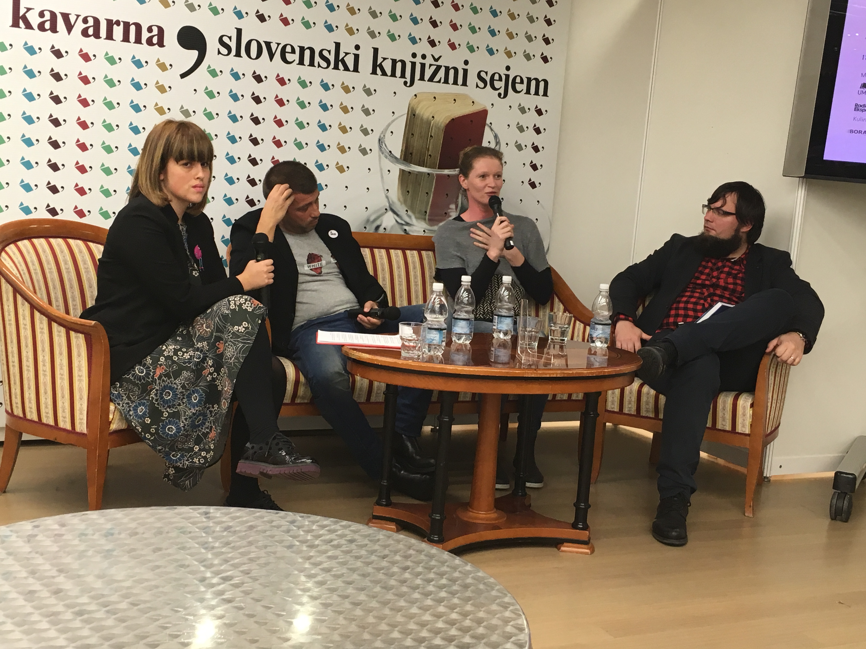

Slide 29
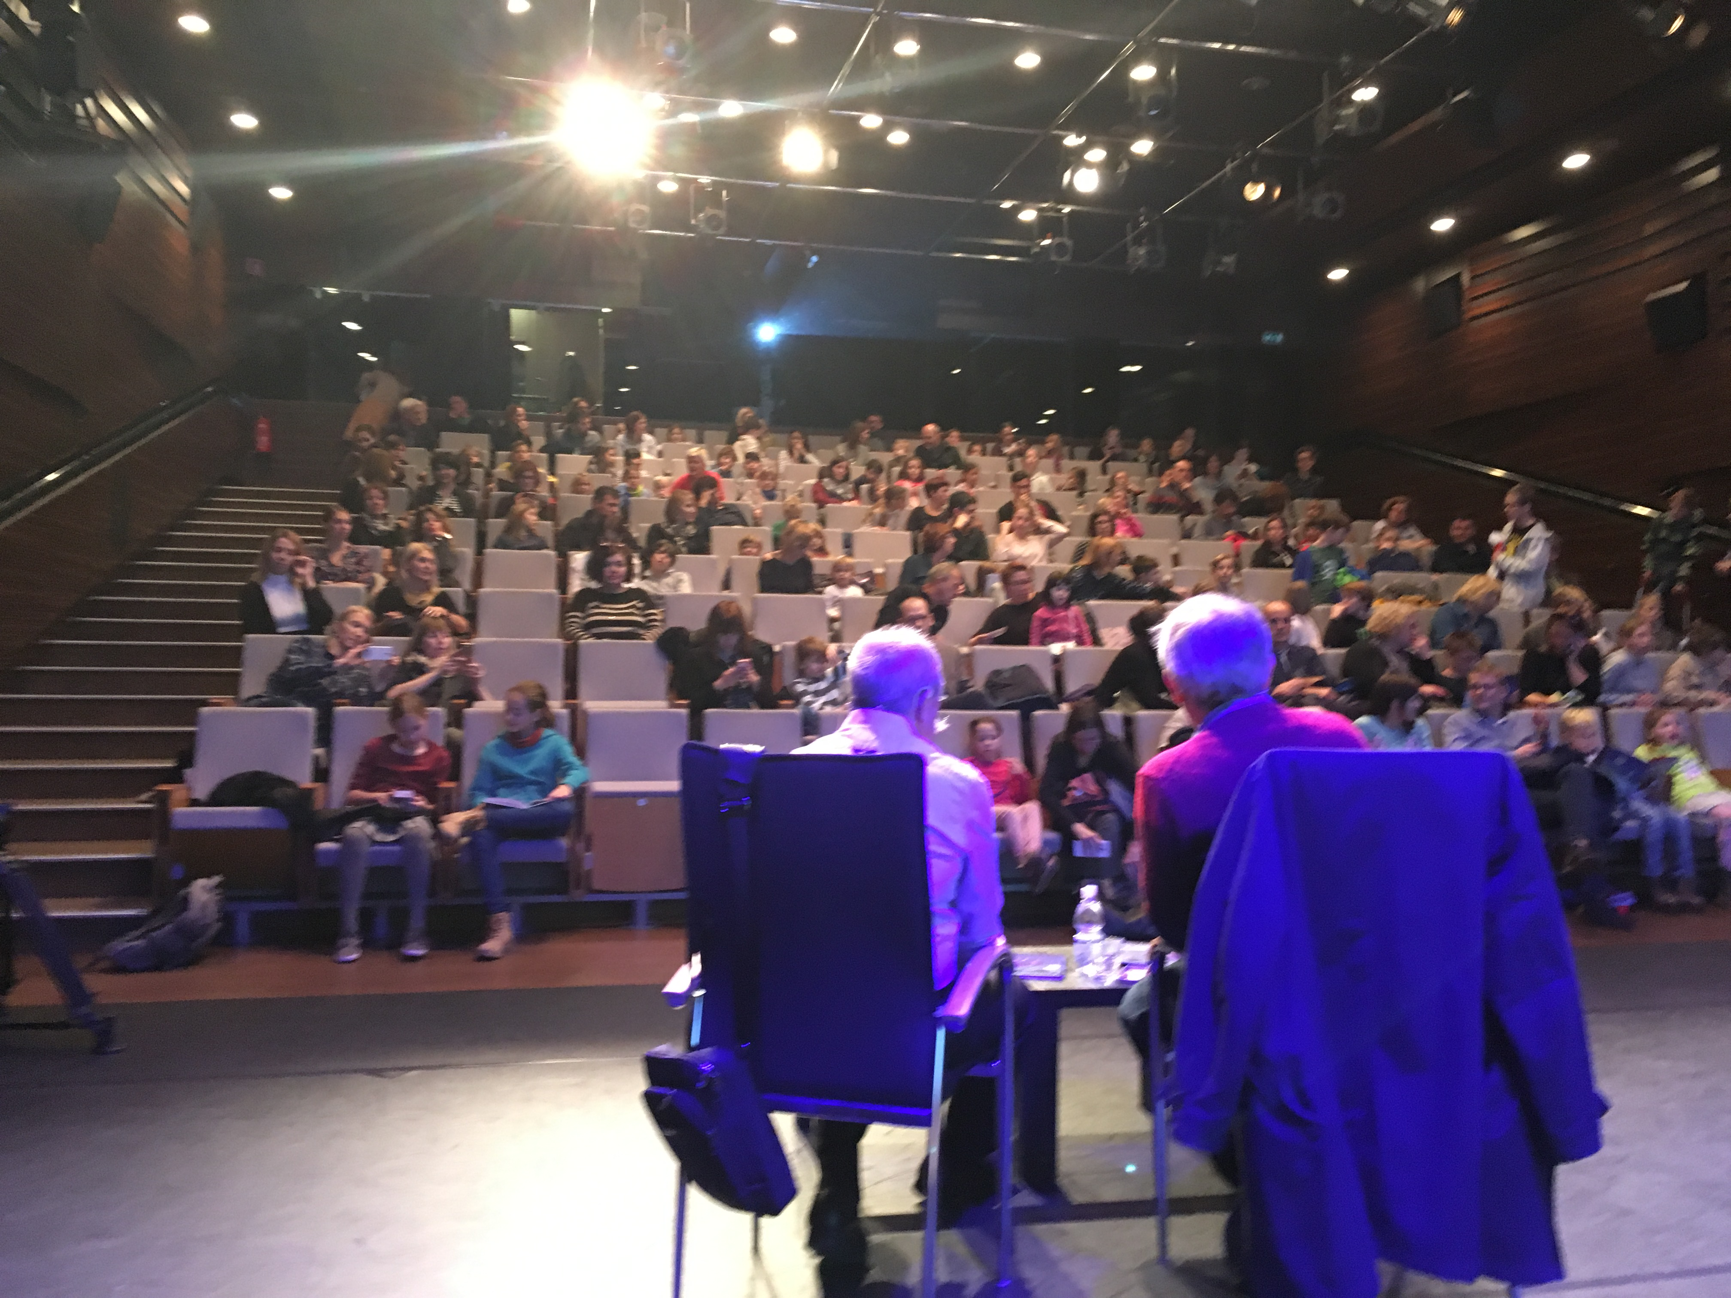

Slide 30
Market developments in the last 25 years
Decline of direct sales (door to door and Reader‘s Digest)
Growth of bookstore sales and other retail channels (i.e., megamarkets, gas stations)
Growth of foreign language/English book sales
Educational market shrank due to state intervention (rental schemes, anti-workbook campaigns)
Result: Drop in average book prices and drop in turnover as well as an overall shrinking of publishing industry (40% in turnover, 15-20% in number of employees).

Slide 31
The main frenemy: Library-dominated market
The library network is widely used and highly developed → 265 library lending points.
3 books per inhabitant are bought each year but 12 books are borrowed from libraries (including extensions).

Slide 32
Changes in public libraries 1998-2021
Between 1998-2014 number of library members grew from 450,000 to 490,000; number of loans grew from 19 million to 24 million; number of employees in Slovene public libraries grew 56%, and their budget grew 41%,; number of events in libraries increased by 157%; and their surface area by 101%.
But the number of library loans grew only 20% and resources for book purchases shrunk.
After 2015, and especially after Covid, these trends reversed: number of library members shrank from 500,000 to 398,678; number of library loans dropped from 24,400,000 to 18,612,682 (together with loan extensions); and the number of events dropped about 30%.
After 2015, resources for book purchases, number of employees and surface area stabilized.

Slide 33
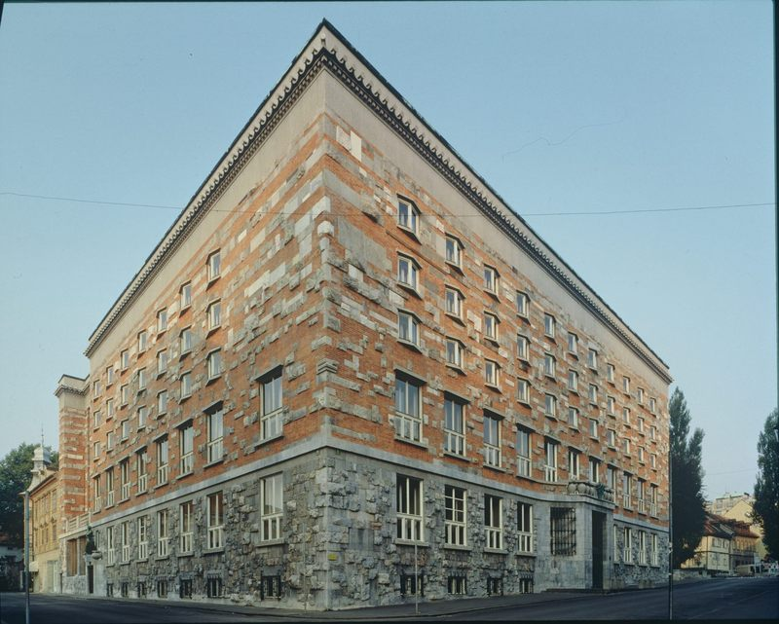

Slide 34
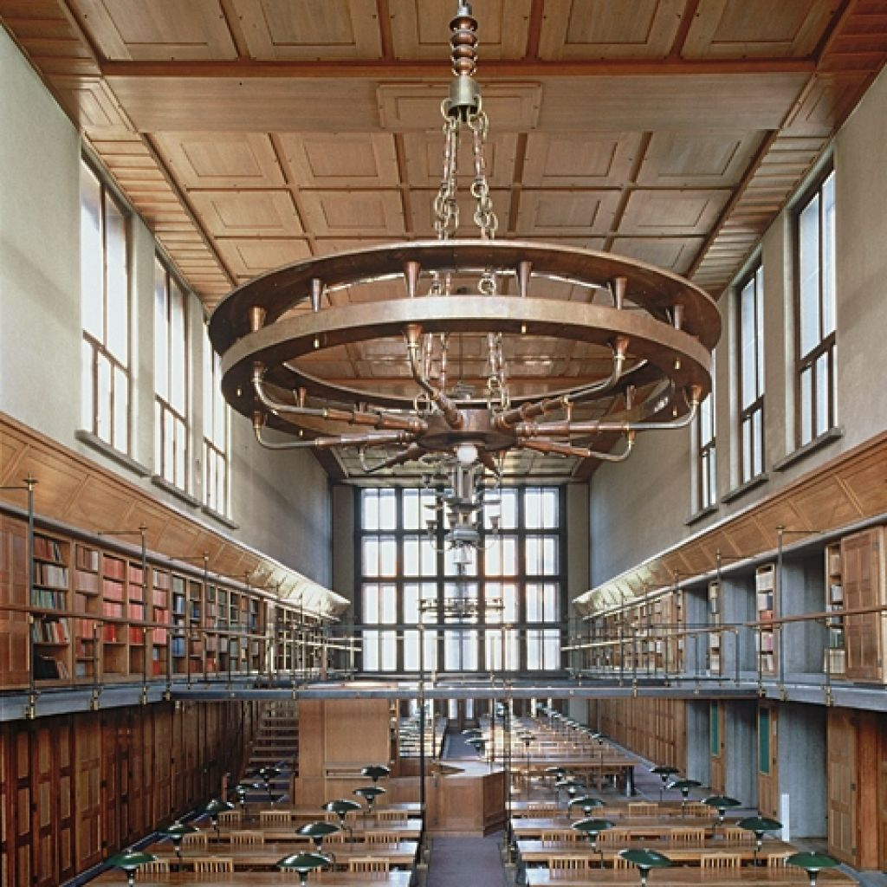

Slide 35
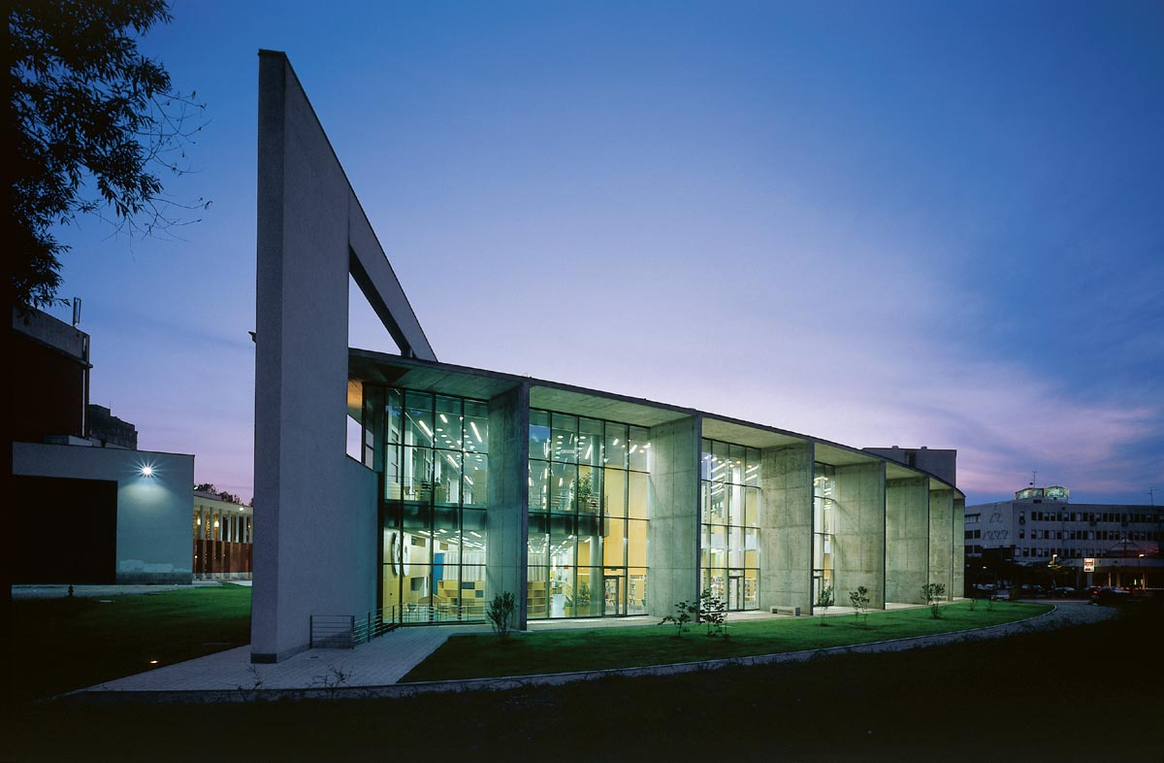

Slide 36
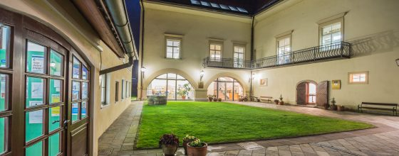

Slide 37


Slide 38
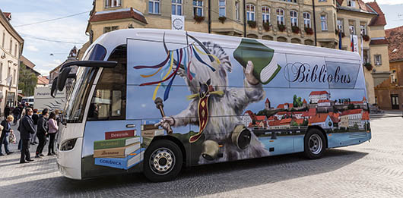

Slide 39
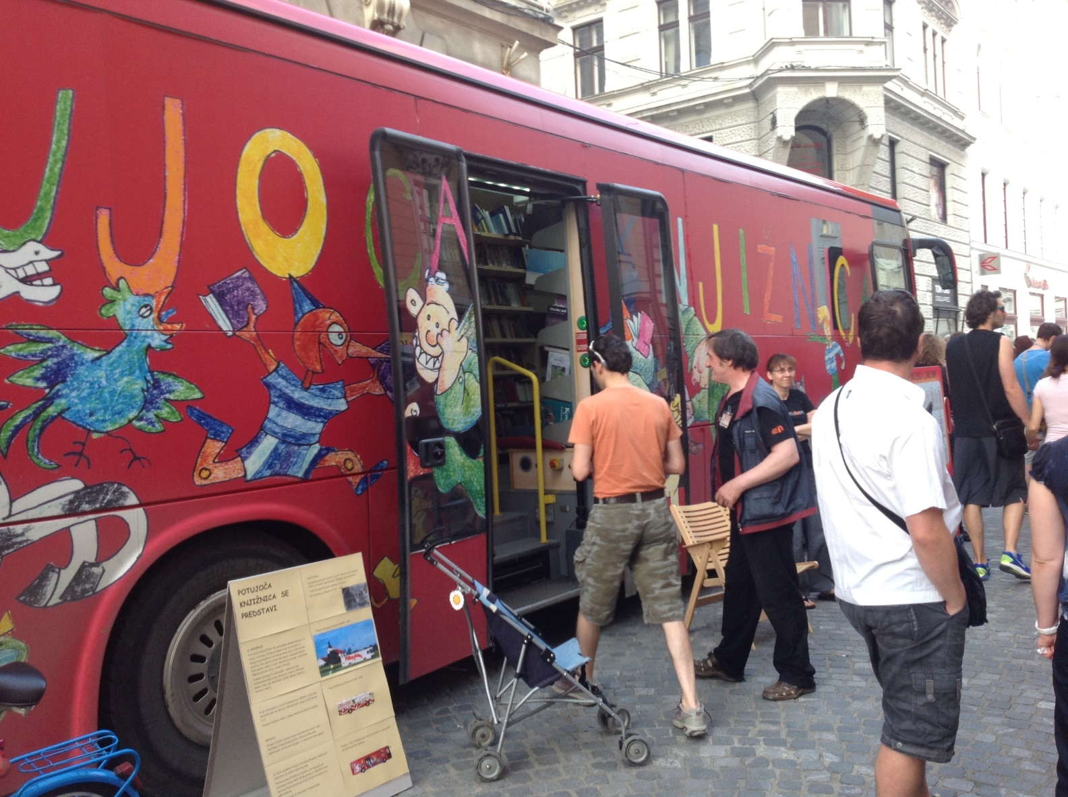
Library bus

Slide 40
The fremeny within: Ebooks, audiboks and public libraries
First ebook in Slovenian was sold in a Slovenian ebookstore on July 2nd, 2013. Yet, a huge majority of Slovenian publishers opted to work with library ebook network that is free for all library patrons. Libraries pay one licence per every 52 loans. This effectively killed the ebook market.
In autumn 2023, there will be a launch of two audibook platforms. Publishers are now discussing how not to repeat the mistake they made in 2013.

Slide 41
Data on reading and consumer trends
About 50% of the Slovene population does not read books. This ratio didn‘t change in last 50 years. However, in recent years, we started to lose those who read 10+ books per year.
Only about one third of Slovene parents regularly read to their children.
In Slovenia, home libraries are among the smallest in the Organisation for Economic Co-operation and Development (OECD).
Number of library loans is above the EU average (number of loans doubles number of sales).

Slide 42
Basic reading trends in reading population
Basic reading indicators | 2014 | 2019
Number of daily readers | 12% | 9%
Readers who read more than 20 books per year | 16% | 11%
Readers who visit libraries at least once a month | 41% | 38%
Readers who also read ebooks | 18% | 18%

Slide 43
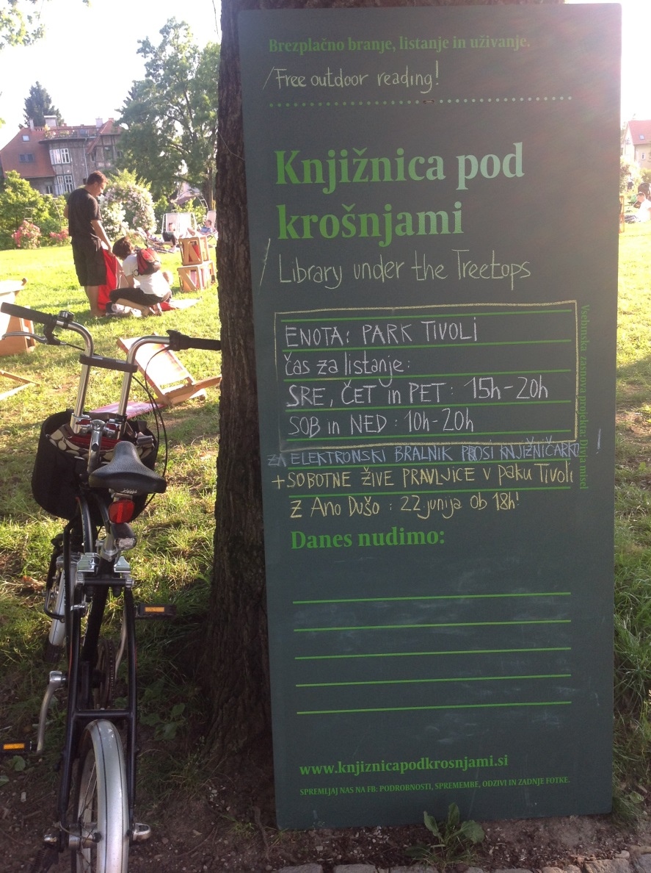
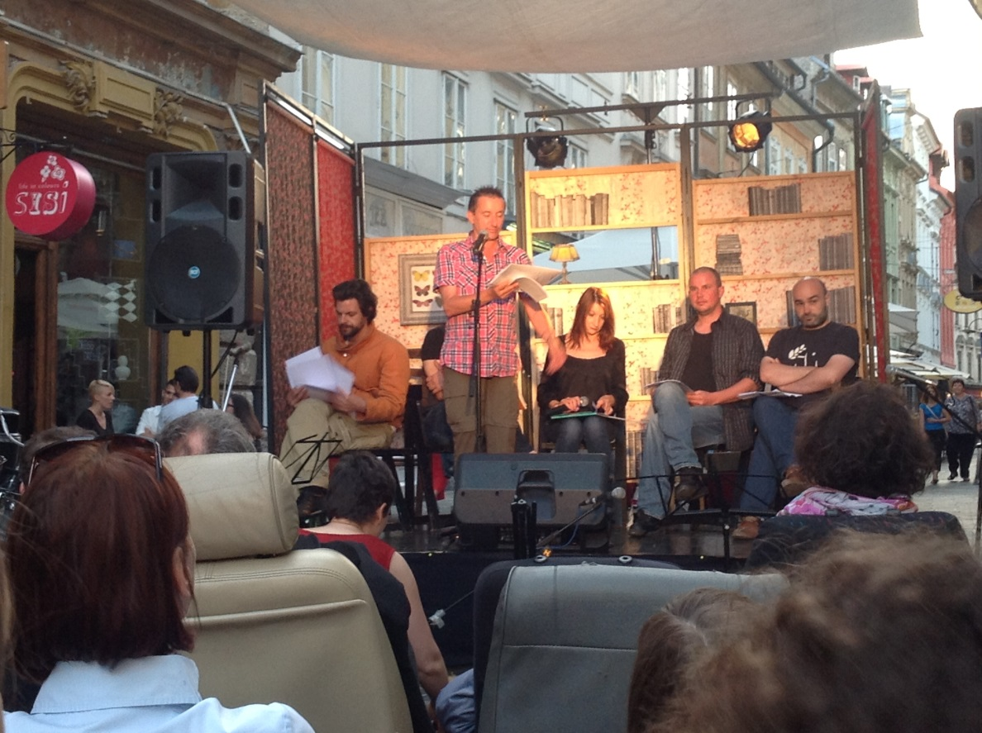
Reading promotion: reading under the treetops

Slide 44
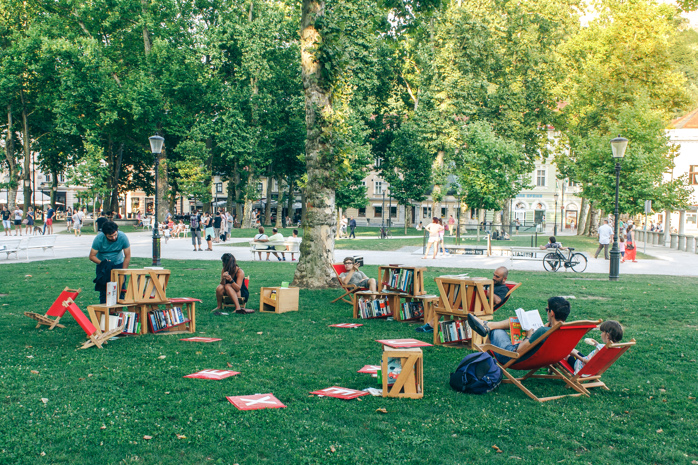

Slide 45


Slide 46
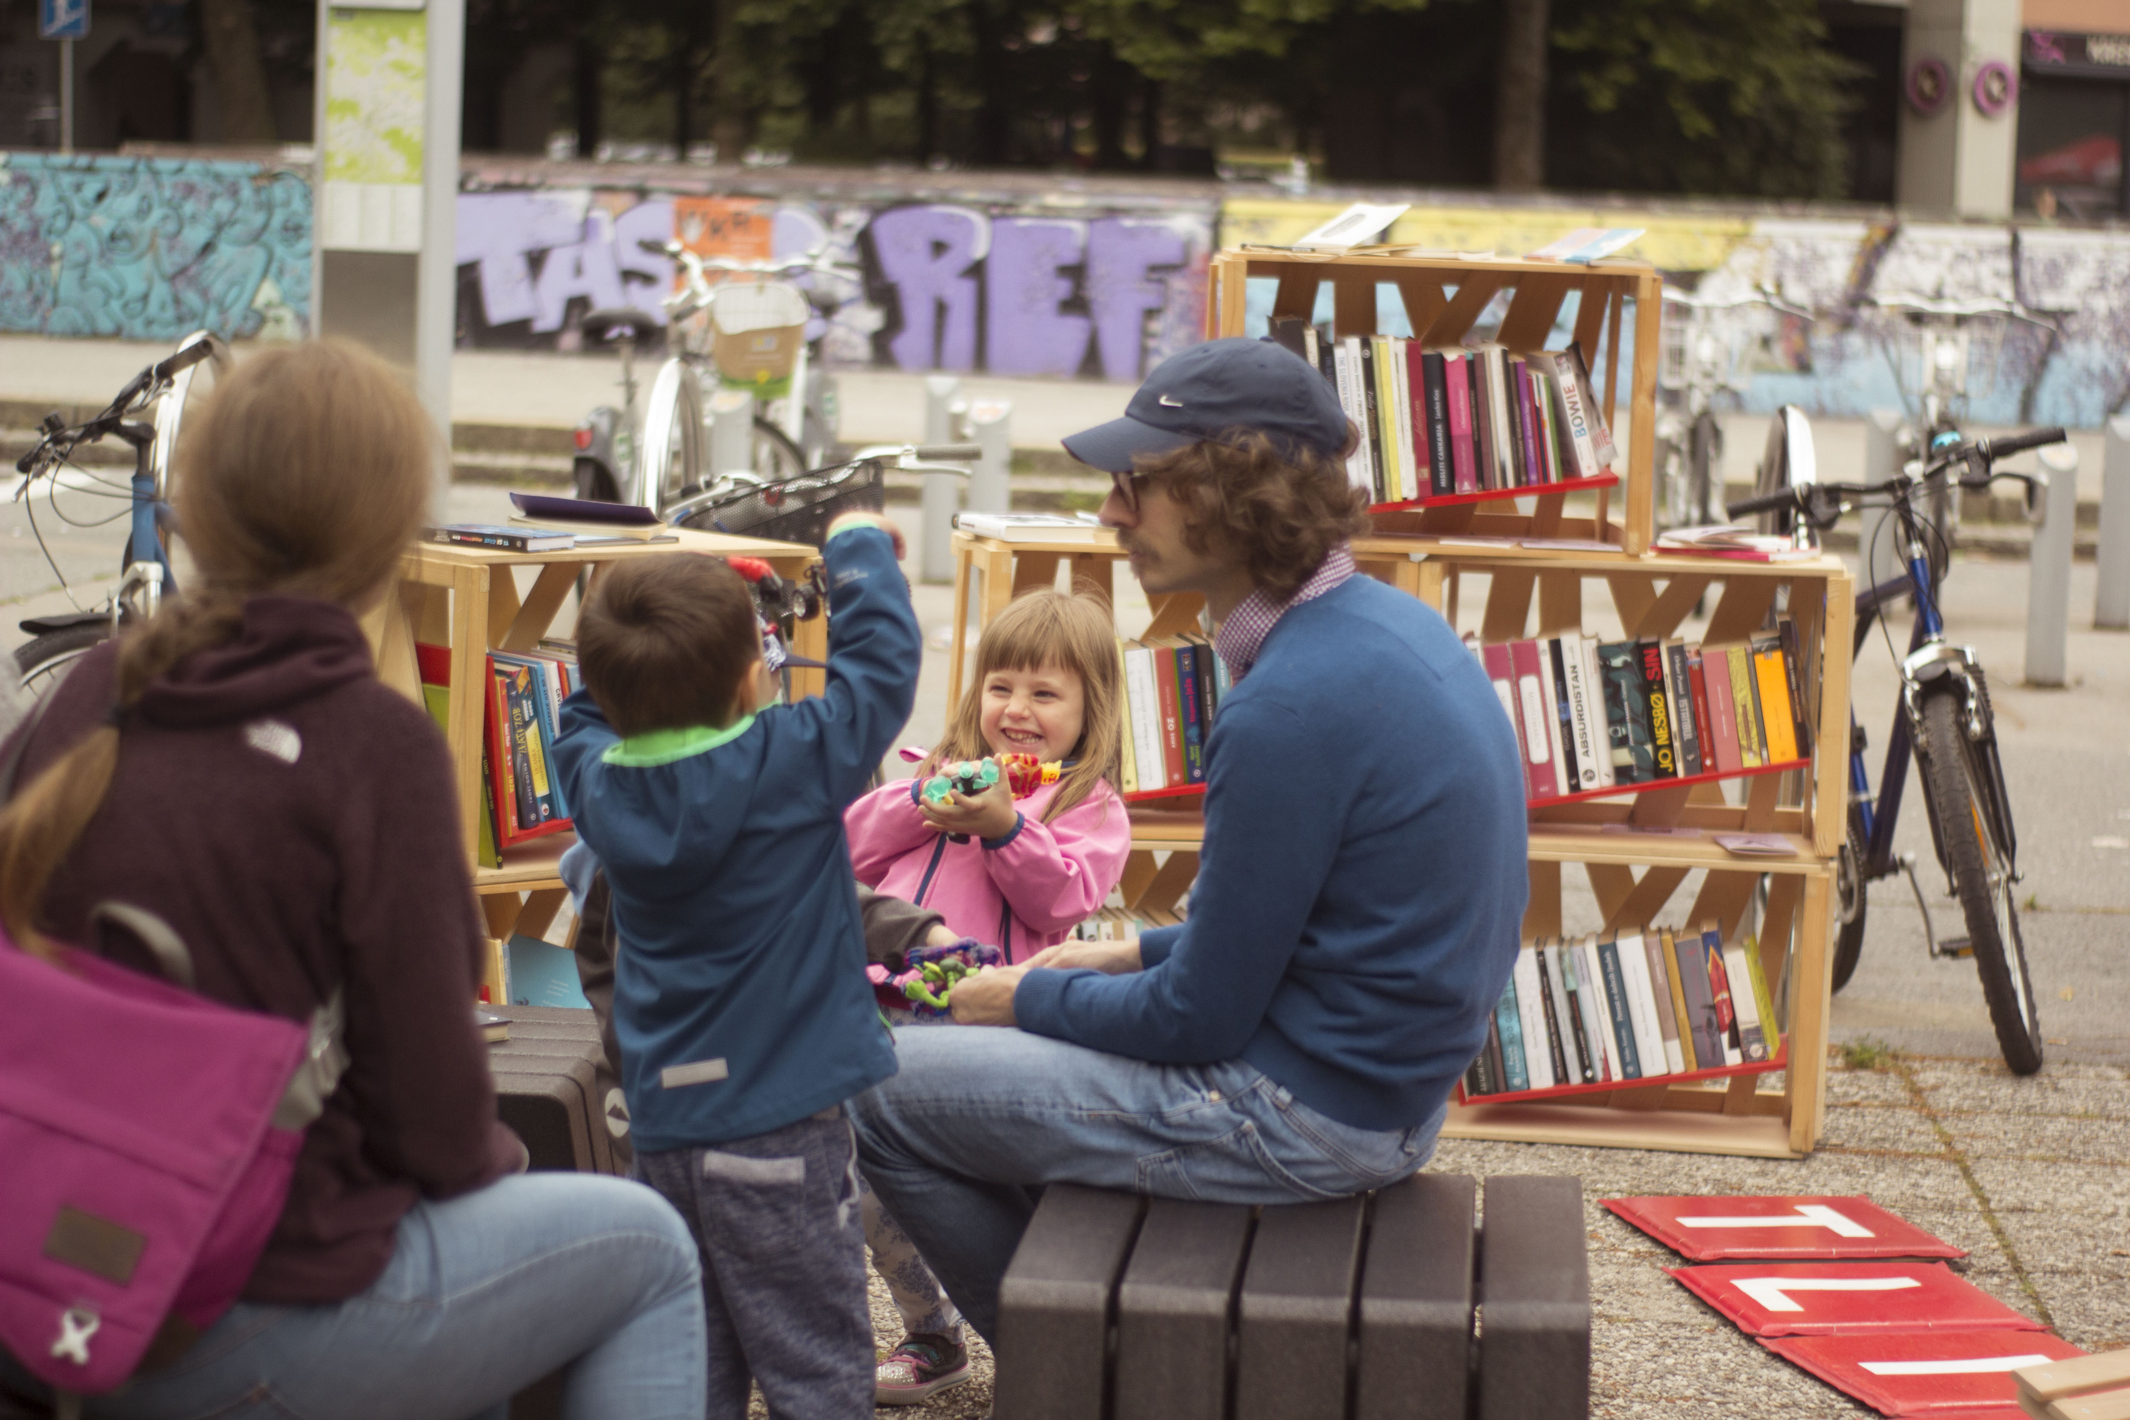

Slide 47
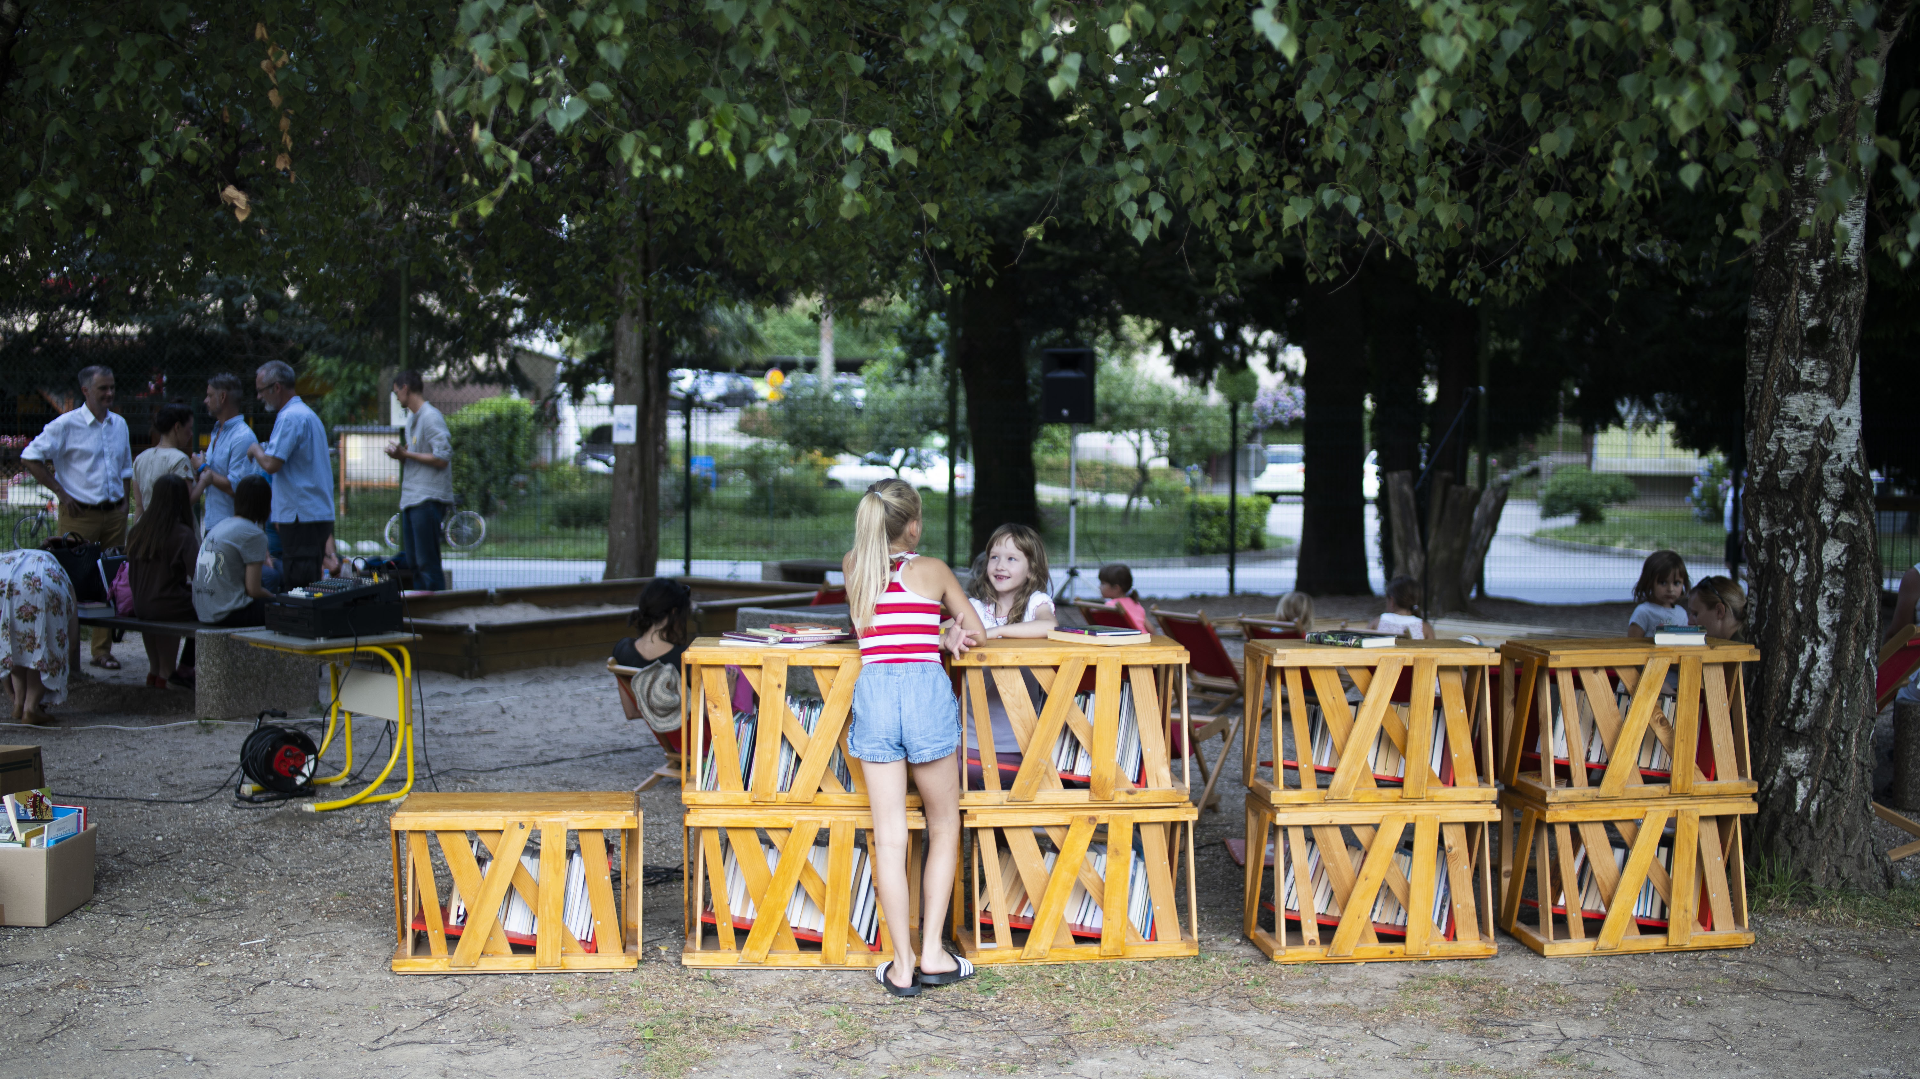

Slide 48
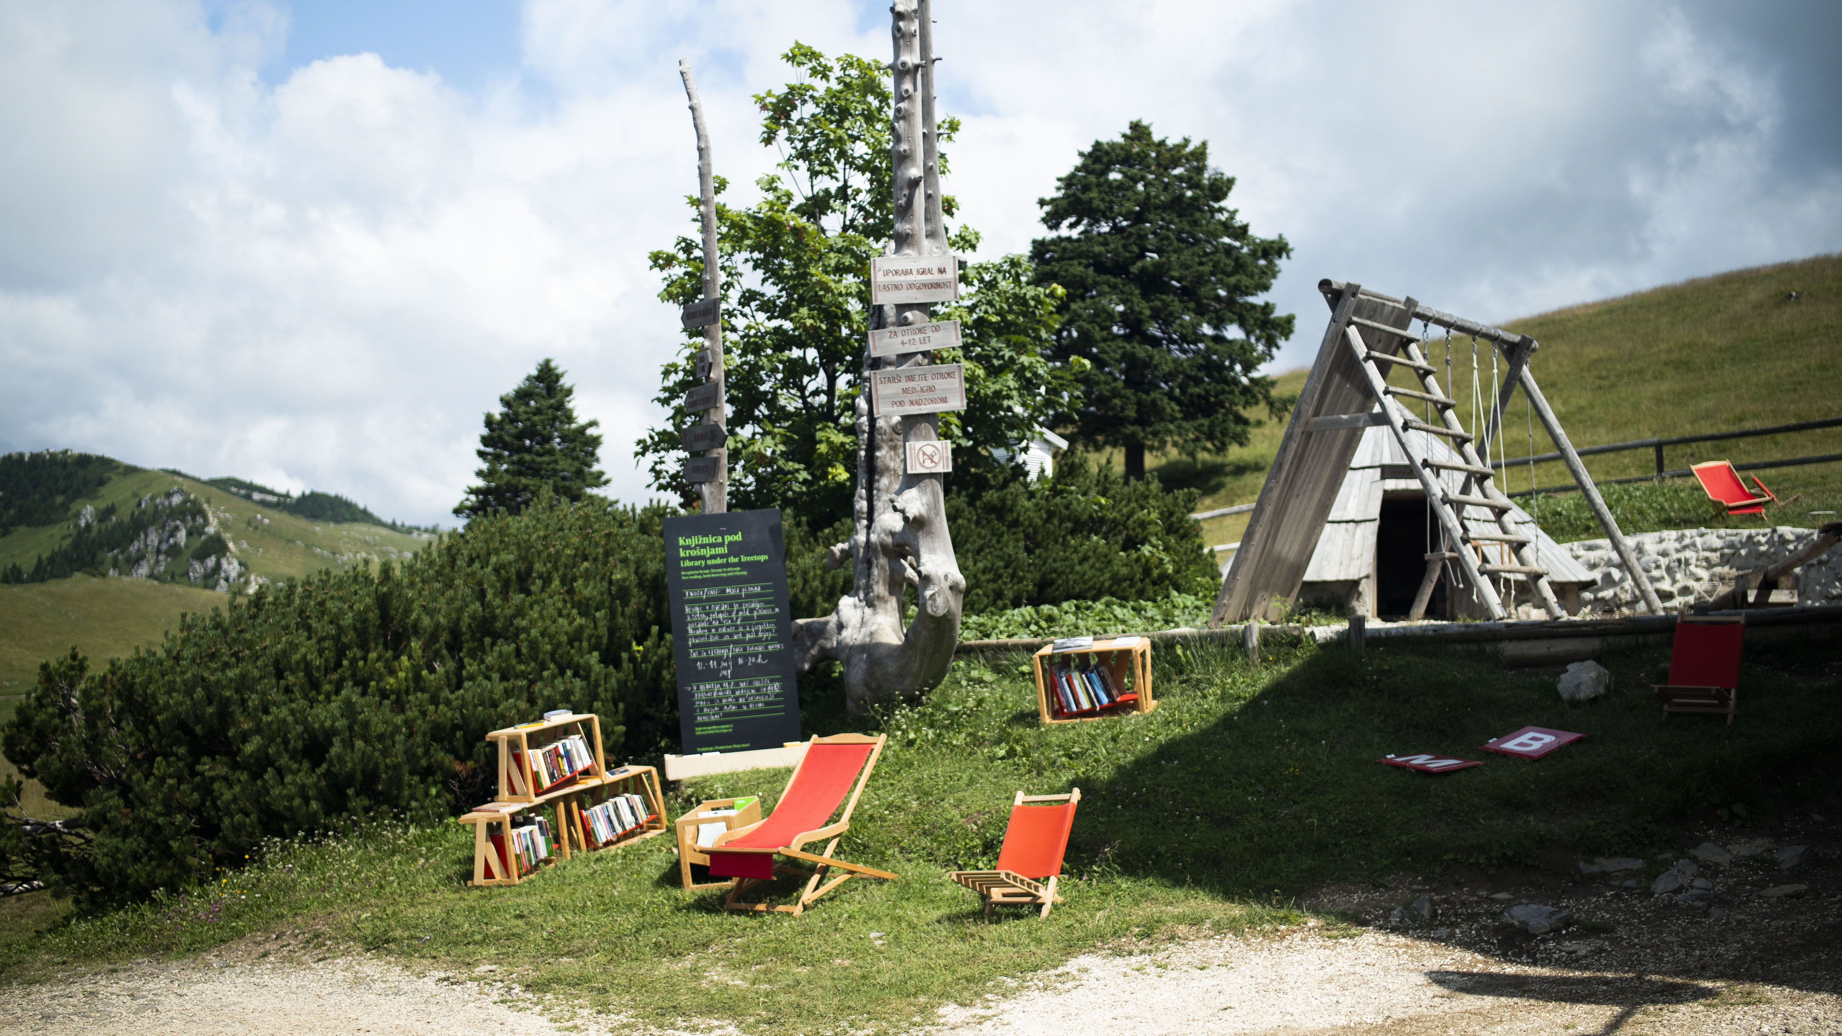

Slide 49
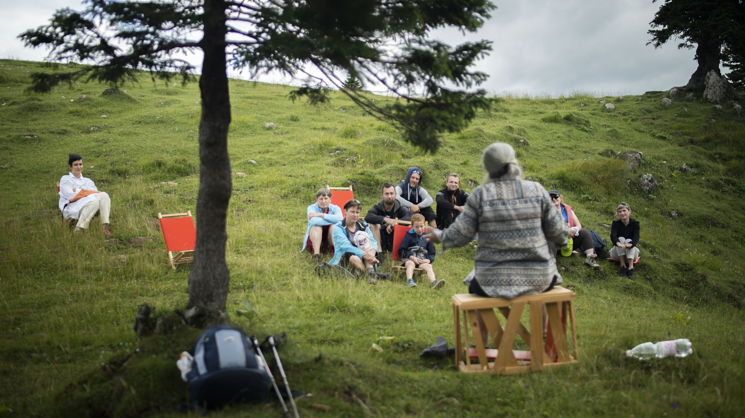

Slide 50
What Slovenia Reads: Top ten titles
There is no reliable bestseller list in Slovenia.
According to publishers’ data, over the last decades, there is a strong shift towards domestic genre authors (Tadej Golob in crime, Bronja Žakelj and Erica Johnson in fiction…).
Non-fiction does well in history and in high-priced segments (for example, in 2019 and 2020, more than 25,000 copies of a monograph on Yugoslav partisan movement priced at 40 euros was sold. That would equall 200,000 copies in Germany and 3,7 million in the US.
In 2023, Daniel Zupančič (a Slovenian version of Adam Kay) sold 5,000 printed copies of his first book in only one month. That would equal 750,000 copies in the US.

Slide 51
The big step forward in last ten years: rights sales
Before 1990, with the exception of Yugoslav languages, translations from Slovenian were almost non-existent.
Between 1990 and 2010, the average number of translation contracts from Slovenian to other languages was 70 per year.
Between 2017 and 2022, the number of translation contracts grew to 200 per year. The main reason for this was GOH activites.
After 2017, German replaced South-Slavic langauges as the main target language.

Slide 52
Slovenian authors with most translations in last three years
Žižek, Slavoj | 125
Flisar, Evald | 33
Kraljič, Helena | 32
Jančar, Drago | 29
Bauer, Jana | 25
Vojnović, Goran | 25
Šteger, Aleš | 23
Klenovšek Musil, Manica | 21
Zupančič Alenka | 20
Prap, Lila | 17

Slide 53
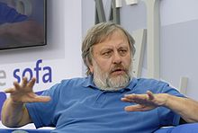
The king: Slavoj Žižek

Slide 54

Master of fiction: Drago Jančar

Slide 55
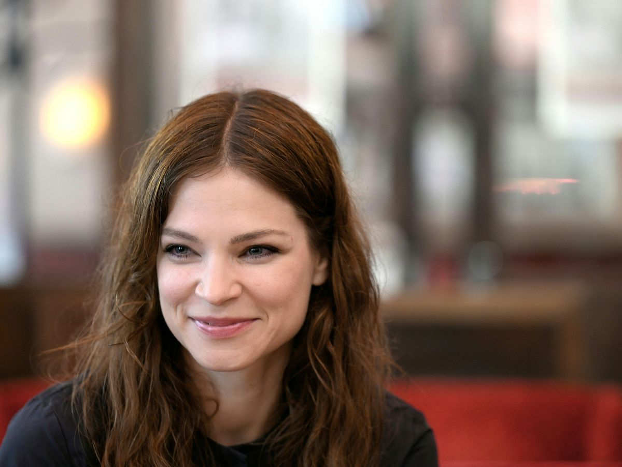
New cosmopolitan generation: Ana Marwan

Slide 56
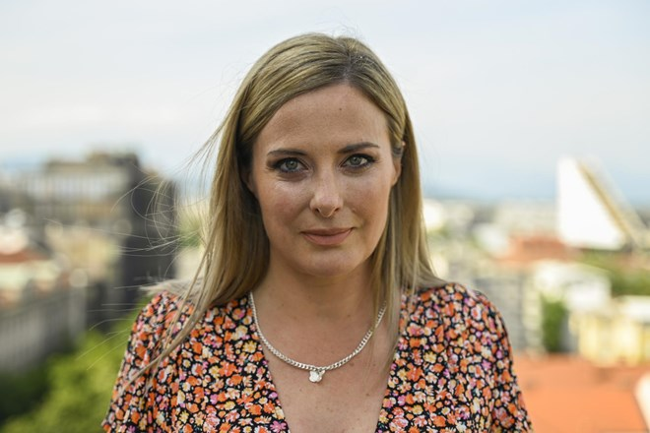
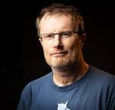

Slovenia Noir: Golob, Svetek, Demšar

Slide 57
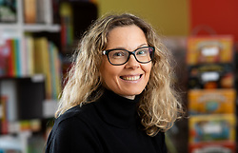
Master of children’s publishing: Helena Kraljič

Slide 58






And many more . . .

Slide 59
Q&A
Please type your questions in the Q&A panel

Slide 60
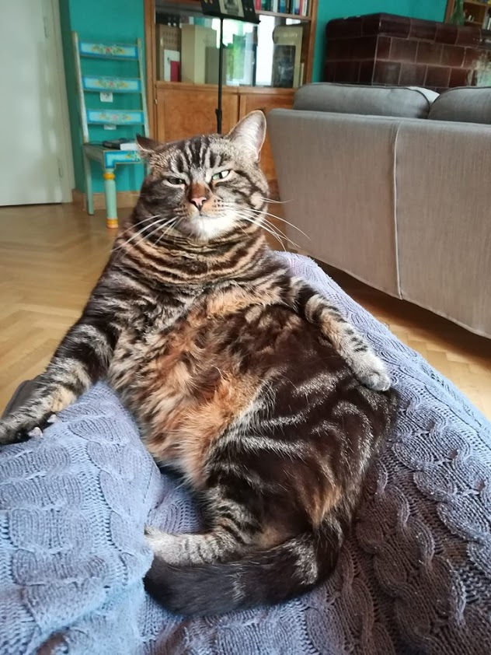
Thank you for your attention.

Slide 61
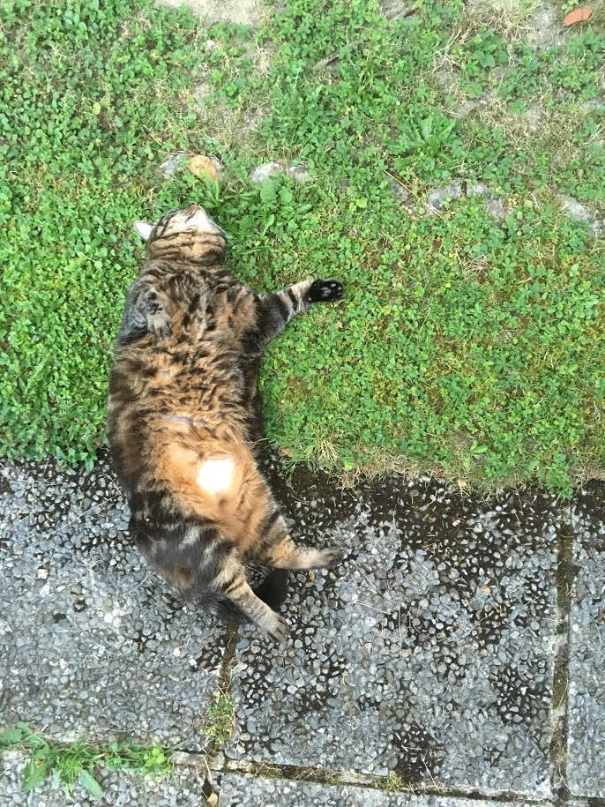
Miha.kovac@ff.uni-lj.si

Slide 62
Thank you
Please fill out an evaluation: https://www.surveymonkey.com/r/N5N9NVB

Slide 63

To watch videos of our previous webinars, visit our website:
https://www.livrescanadabooks.com/Webinar-Archive/

